Slide 1
NZDSN National Symposium “A Mums Story” & Wider Family and Whanau input

Slide 2
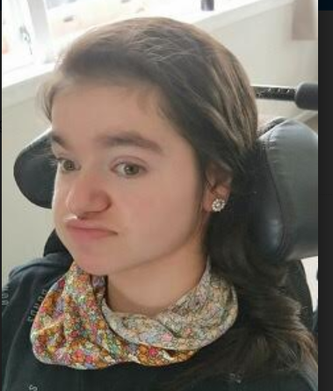
Supporting Our Daughter Post School
Notes:
Meet Nikki – has a few challenges in life, but I never refer to her as ‘Very High Needs’ Not the language of some Families and Whanau.

Slide 3
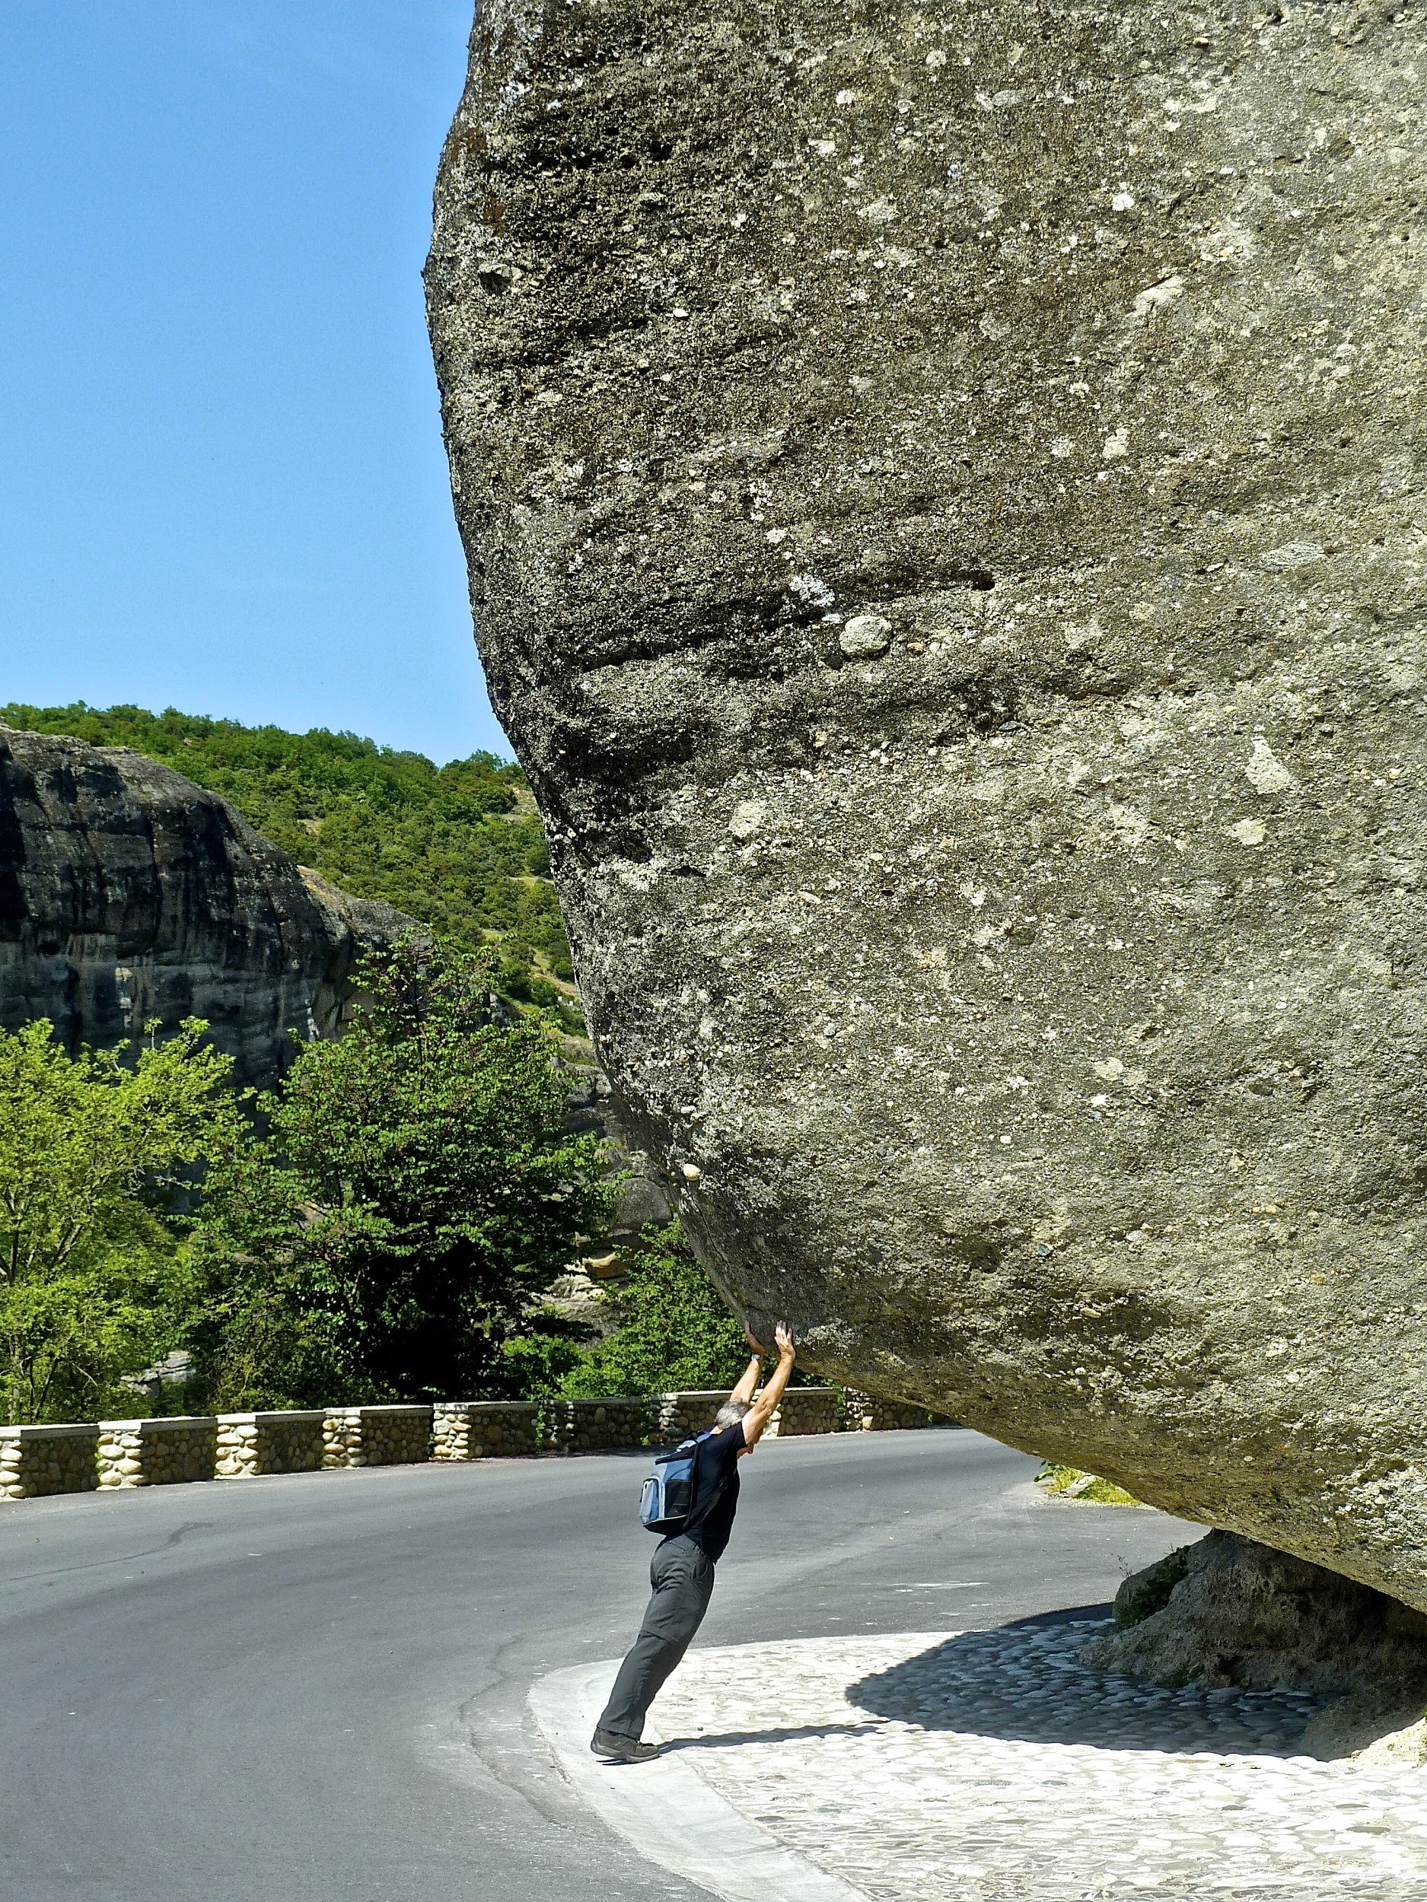
Some challenges
What does our daughter want?
Finding a home in the community
Find something meaningful during the day
Solution Focus
Me Time
Notes:
Supported decision making – wide range of people who know her well with a very keen ear to hear from her siblings, and peers similar in age.
Engagement with provider ‘in the know’ – found a house
What does the day look like amongst some challenges
Find a way through – find allies.

Slide 4
With and EGL lense on ideas;
Life can look different;
Ordinary Life outcomes
Relationship Building
Easy to use
Mana Enhancing
Notes:
Some principles that come to mind; Ordinary Life stage and age, (Car and House), Build trusting relationships, Easy to use, Keep everyone's Mana intact.

Slide 5
Still working on
Community Acceptance
Earning opportunities
‘How can we’ attitude
Notes:
How can we move mind-sets of community, & people. Earning – home ownership. Together we can.

Slide 6
Hints and Tips from Families and Whanau
Partnership
Transition
Balance between safeguarding and living
Some Families and Whanau need time – to figure out what ‘can be’
Mid Central Family Core Group
Notes:
Additional information from Families and Whanau nationally from Care Matters and Mid Central RLG
Partnership – Providers, schools, effective communication. Walk along side – together.
Transition needs to start at the beginning of high school. Very High Support needs – limited understanding and commitment to post school options . Crucial. IT Communication
Often people with Very High Needs have Families, Agencies, and advocates involved with them. Working together for the best Good Life.
How do we build trusting relationships together to gain the best interests of the person in and EGL way?
Families have been told what they can and can’t have. EGL is about what can be.

Slide 7
Hints and Tips from Families and Whanau
Trust – Right people for the job
What will it cost?
Agile support
Succession Planning
Mid Central Family Core Group
Notes:
Providers and workforce - Initiative - - try other ways to offer support if one way doesn’t work. Flexible. (Try and Try again) Hire the right people for the job (passionate, have a heart, can do attitude, solution focused)
Work with the person and families in partnership.
Some families want little support , while others want providers to do it all. Move quickly in a timely fashion – if things aren’t working – keep informed and communication open .
Some families dreaded through ‘ what will happen to my family member when I can no longer support them? How do we work together. If we can all focus on the EGL principles – we may get there together.

Slide 8
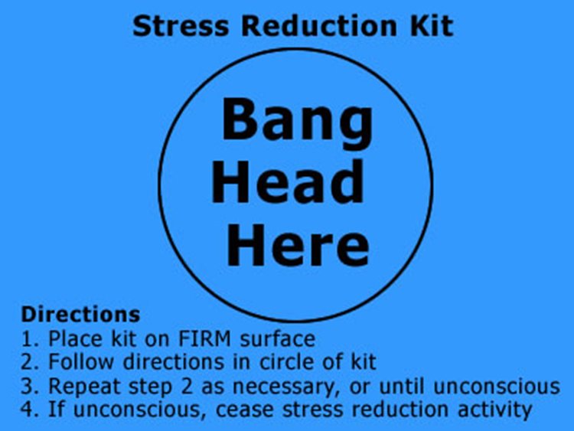
Tried it …. It didn’t work!!!

Slide 9
Thank you for your time today

