Slide 1
Introducing
Mykal (and theo)

Slide 2
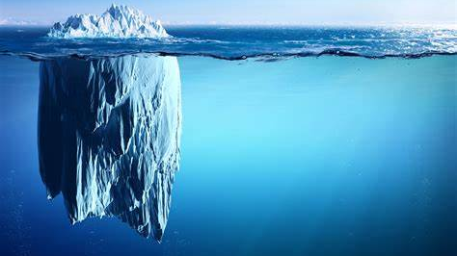
Parenting a child with a significant disability …not for the fainthearted
Complexity of navigating who and what and when
Waiting times – appointments and/or equipment
Lack of (or plain wrong) information
Forms, criteria, applications, requests, reviews
Ever changing personnel & processes
Judgements – life under a microscope
Constant advocacy
System based not person centred

Slide 3
School

Slide 4
The most discouraging things I have ever heard said about Mykal, have been said within the education setting

Slide 5
Disability Providers
This Photo by Unknown Author is licensed under CC BY

Slide 6
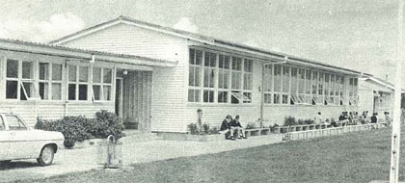
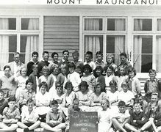
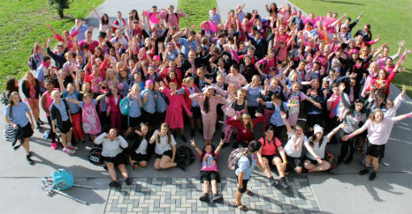
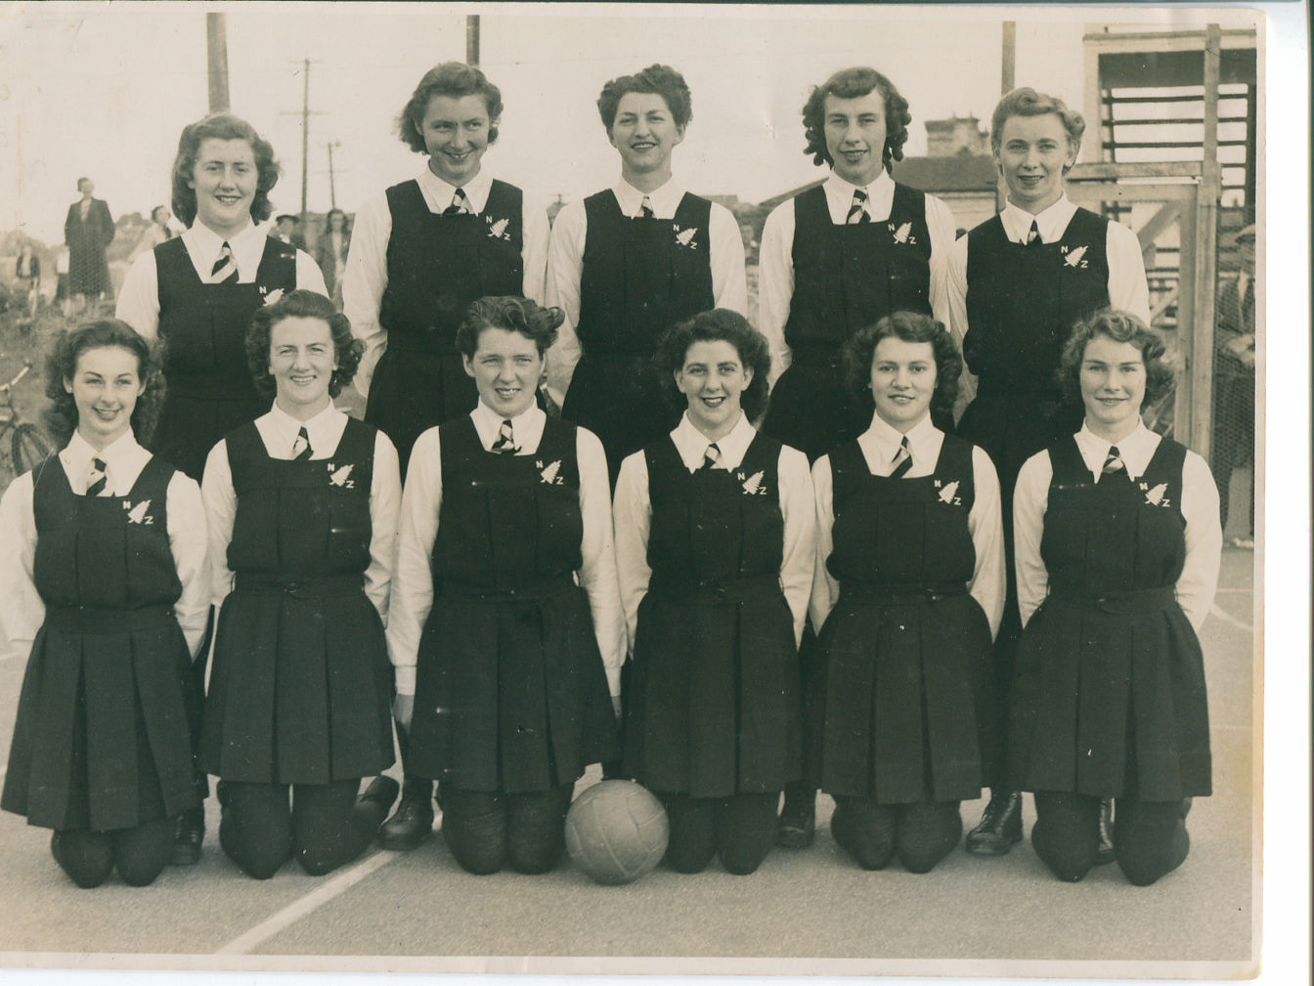
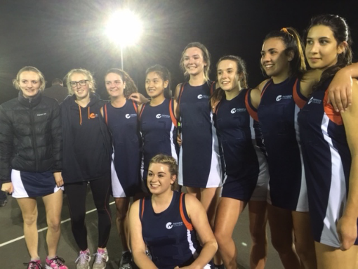
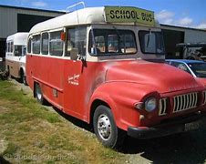
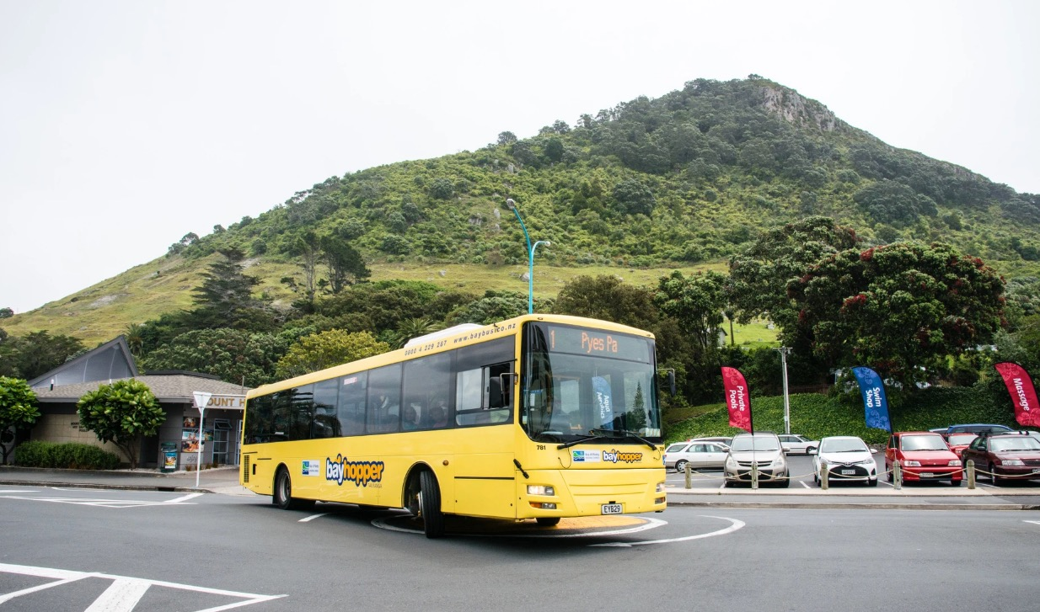

Slide 7
Enabling Good Lives
Institutions
Group houses
Day services
Ordinary Life outcomes
Work that I enjoy
My own Home
Independence
Financial means
Relationships
Part of the community
Choice & control over my own life
Individualised support
Individualised funding
‘A life like any other’

Slide 8
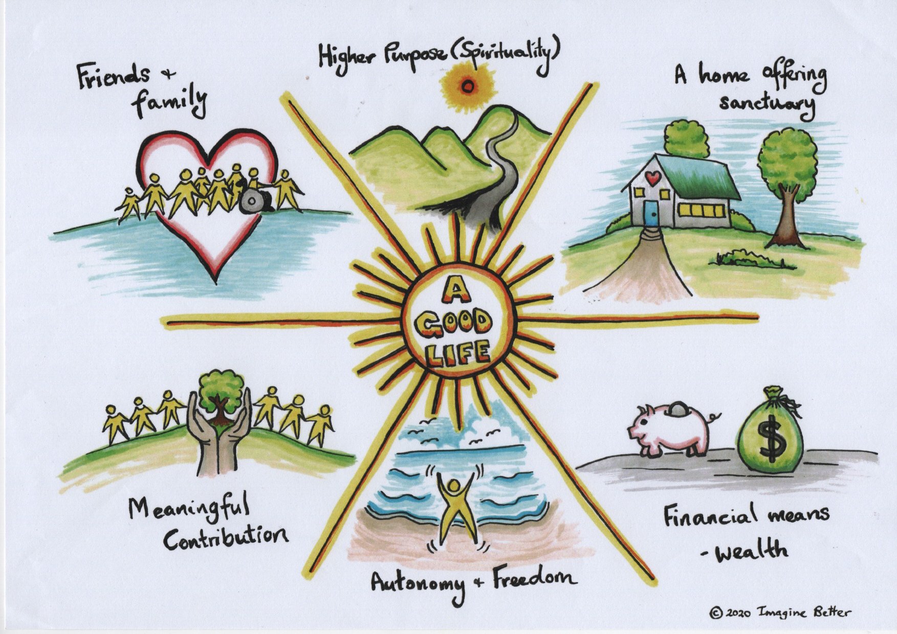
A foundation to unite: the good life
Believing there is a ‘good life’ available to all people
Talking and dreaming about after school from age 14
Thanks to Imagine Better for this image (www.imaginebetter.co.nz)

Slide 9
The power of vision
Vision sets the course
Vision informs the big and the little steps
Vision unites people from all different perspectives/expertise/experiences
Vision harnesses the strength and energy of many
Vision gives a shared language and understanding
Vision invites people on the journey
Vision gives meaning and purpose to life
AND it means
The complexity of the ‘system’, of contracts, different perspectives, funding, changing staff, SOP’s etc lose their power

Slide 10
Filled with possibilities – only limited by the imagination of the people in your world

Slide 11
