Slide 1
Skills, Knowledge and Transitions help ensure working matters
Matt Frost and Lauren Bell
Ministry of Education
NZDSN Symposium
30 September, 2020

Slide 2
Context
Opportunity to align work across Ministry of Education (MOE) and Tertiary Education Commission (TEC) to support the DEAP
Work programme includes both specific Learning Support initiatives and wider Ministry work programmes (e.g. Reform of Vocational Education)
NEET rate for disabled people aged 15-24 is 48.8%
Means we need to be focused and yet adapt to context (e.g. COVID-19)

Slide 3
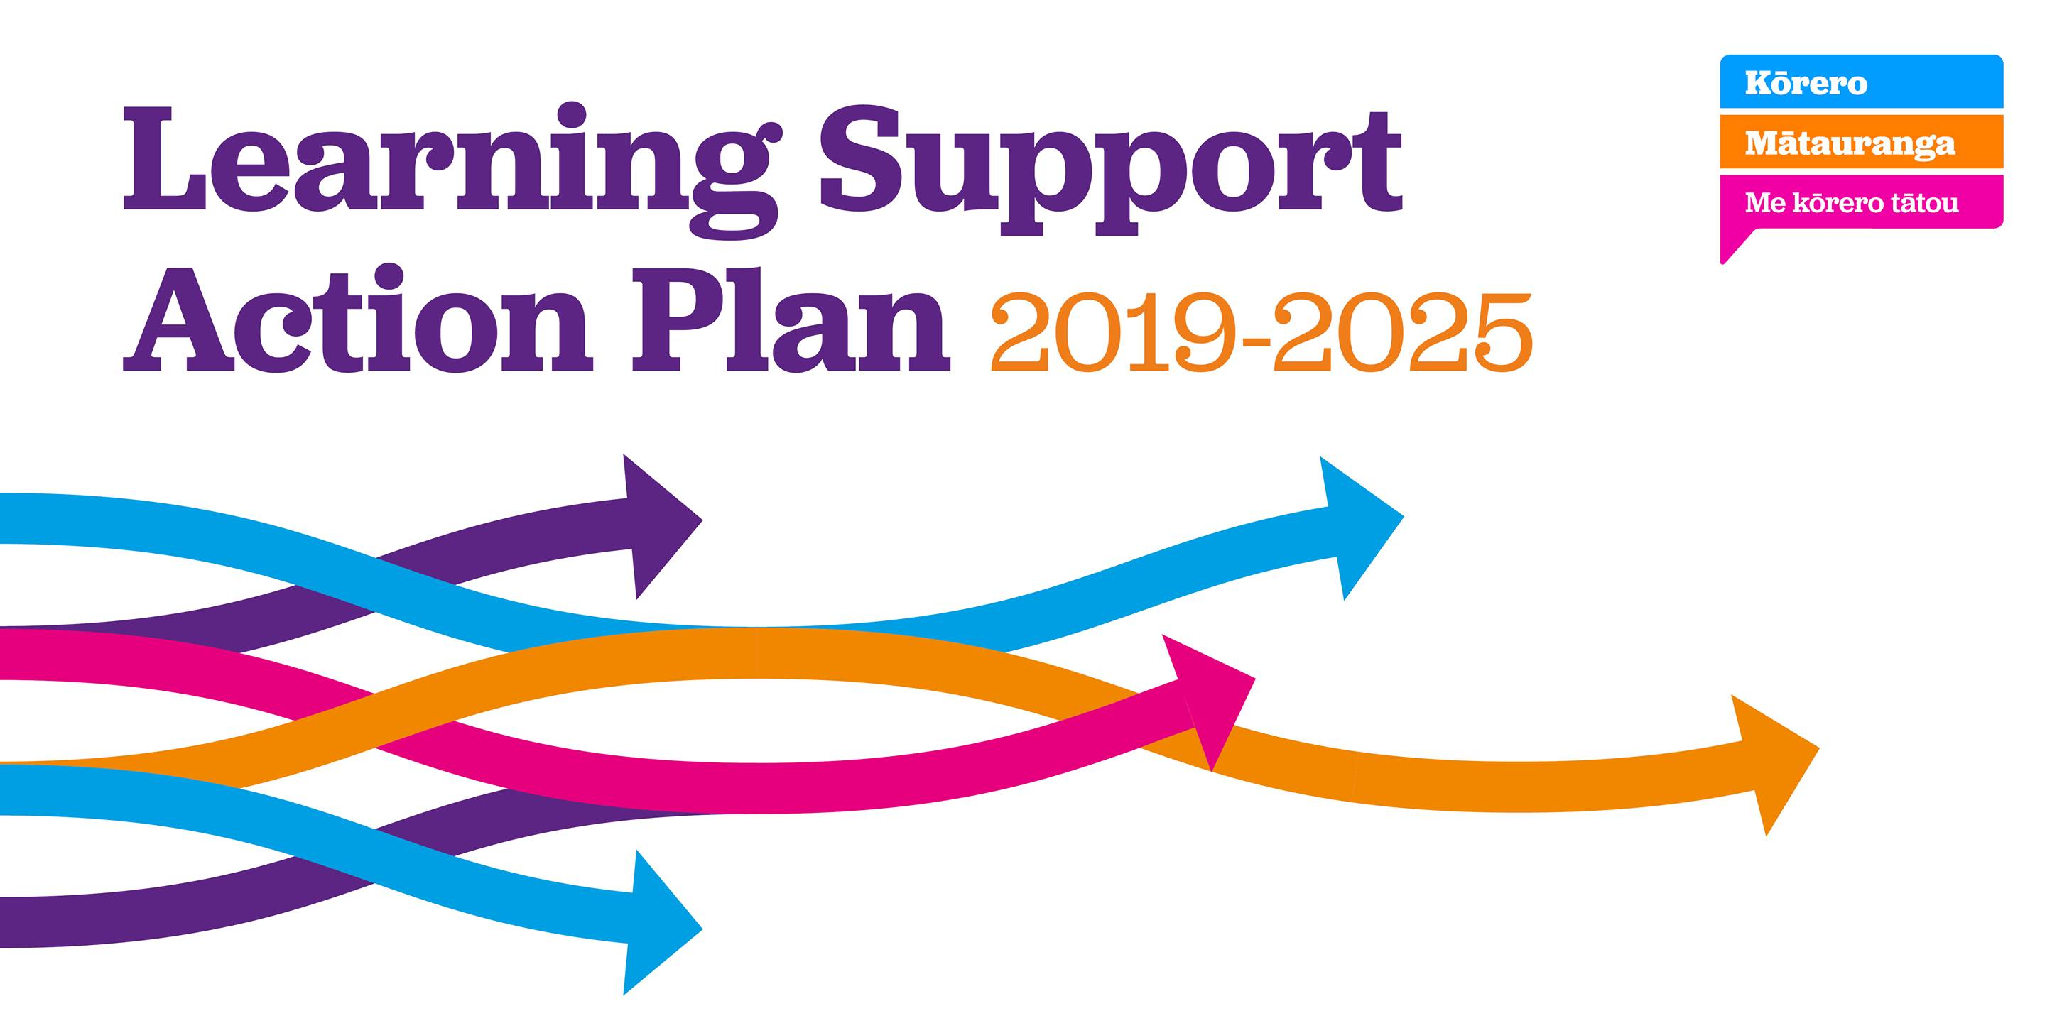
Learning Support Action Plan
Learning Support Coordinators – link to leadership and developing links to transitions
Recognition that some learners (e.g neurodiverse) require additional targeted supports and tools and resources

Slide 4
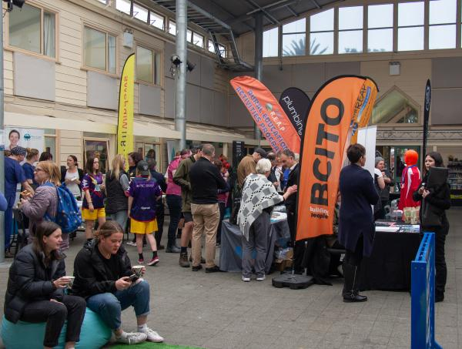
Education to Employment
A nationwide programme which promotes vocational learning, trades and “earn while you learn” access to young people
Kura and state schools from years 7-13 can run vocationally focused careers events in schools
Accessibility of events important to the Ministry
https://www.education.govt.nz/school/student-support/supporting-transitions/education-to-employment/
Image sourced from: Tai Poutini Polytechnic website

Slide 5
Unified Funding System – Learner Component
Current equity funding is haphazard and limited
One of the key changes of the Reform of Vocational Education (RoVE) is a new unified funding system. This system will have 3 parts, one being the learner component.
The learner component will:
Support providers to improve system
performance, particularly for under-served
groups
Make sure the funding system better
recognises the additional costs for tailoring
education delivery and support

Slide 6
Learner component - opportunities for Disabled Learners
The current learner component proposes funding to support disabled learners in their education journeys
For example, one way the proposed funding could be used is to help deliver accommodations which are higher cost
Engaging on the UFS now so keen to hear any suggestions on how it could best meet the vocational needs of disabled learners

Slide 7
Questions?

