Slide 1
Approaches to Self Employment Opportunities and Safeguards
November 2020

Slide 2
Definition of Employment
work in the open labour market in a job not reserved for a disabled person and paid at or above the minimum wage, or being self-employed
Employment Practice Support Guidelines (2018), NZDSN

Slide 3
Model Assumptions
There are a range of model options i.e. 1:1 | small group | large group | ‘social enterprise etc
We align business development to the spirit and intent of best practice employment support: one person matched to a customised or tailored job i.e. one person – one business
Single person enterprises enable 100% customisation
Single person enterprises enable 100% match to interests, gifts and passions
Single person enterprises enable 100% personal expression

Slide 4
WHY?
Globally more people create a living through self-employment or ‘micro-enterprise’ than any other method
Creating your own work is a valid response in both the ‘sophisticated’ West and the Global South
Entrepreneurs always have a why – is it flexibility or lifestyle or is it necessity for living? We need to really consider the why question

Slide 5
WHAT?
Product or Service

Slide 6
Chris’s K9 Krunchies

Slide 7
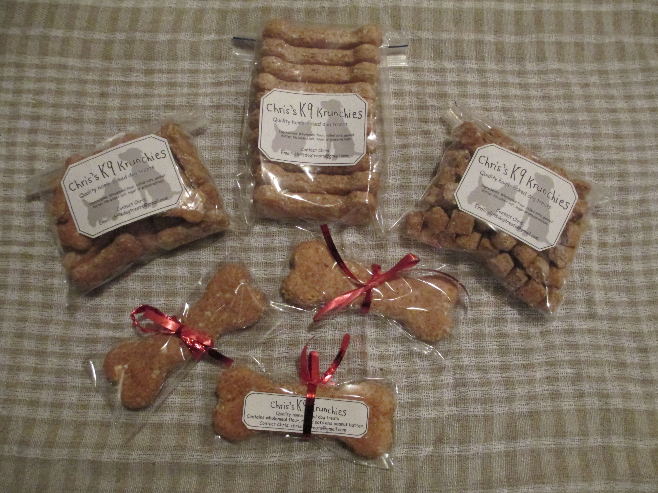
Notes:
7

Slide 8
Art by Anne

Slide 9
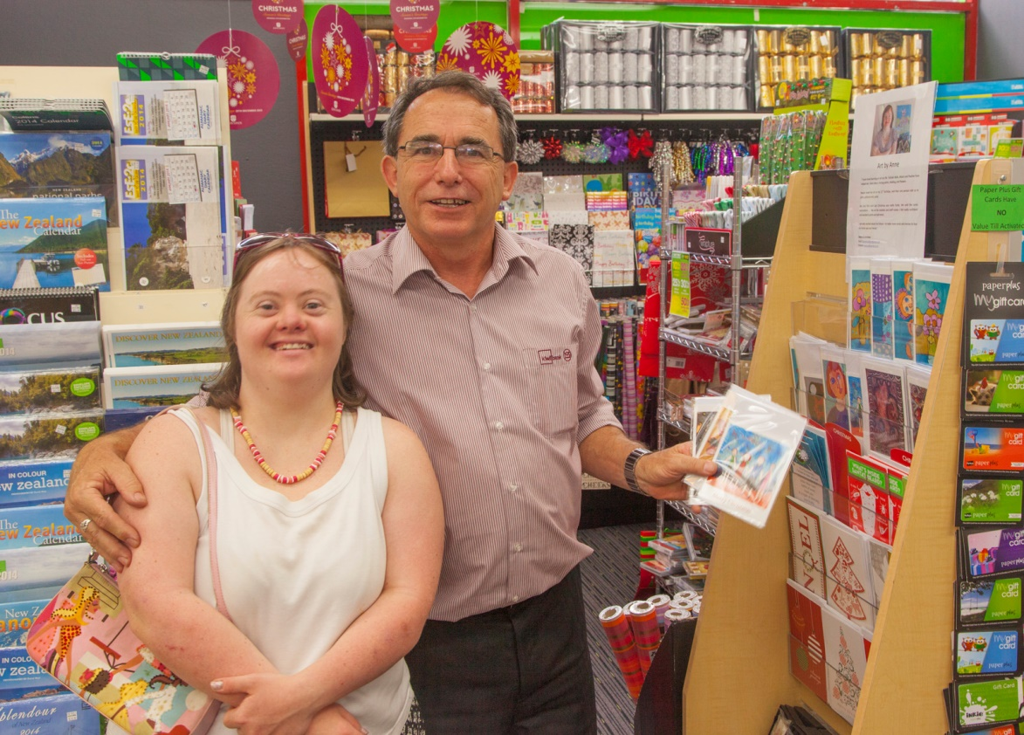

Slide 10
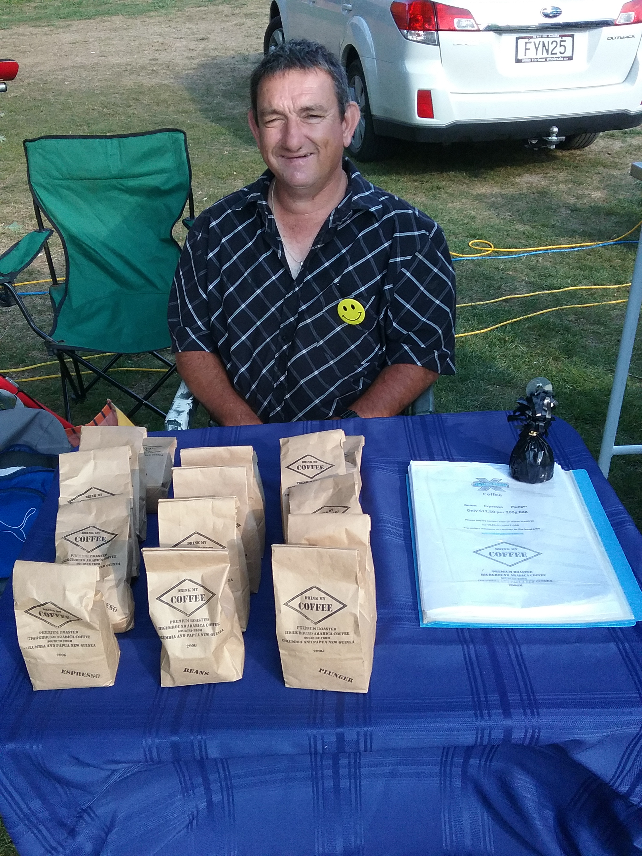
Drink my Coffee: Jeremy

Slide 11
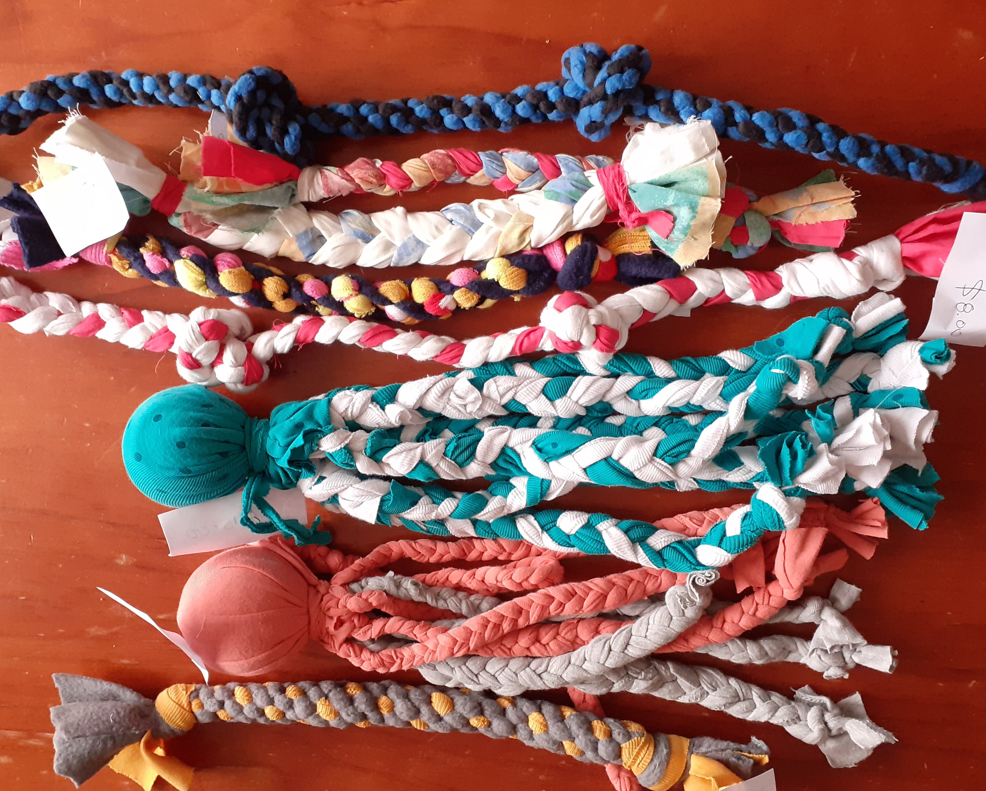
Renee’s Dog Toys

Slide 12
Paua by Dan

Slide 13
https://www.pauabydan.co.nz/

Slide 14
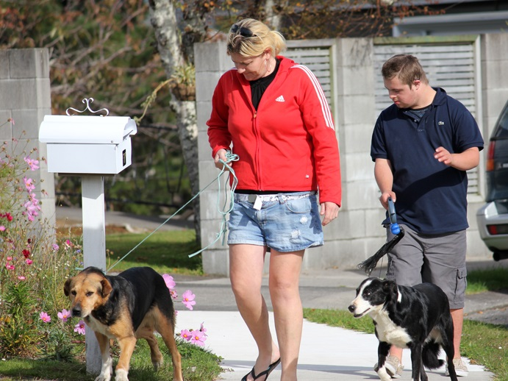
Leader of the Pack: Bill

Slide 15
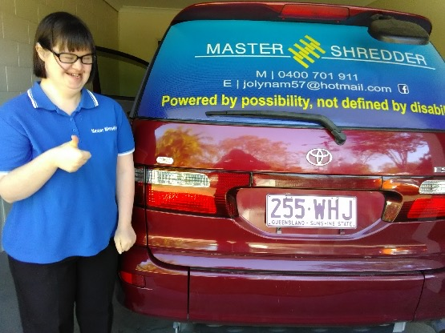
Master Shredder: Emma

Slide 16
JACKMAIL https://www.youtube.com/watch?v=90PQjH7pD1U&feature=youtu.be

Slide 17
HOW?
Imagine Better delivers a practical, application focused 2 – 3 day event on the methods and methodologies for supporting people to create their own work.

Slide 18
Essential Considerations
Don’t give up on paid employment (Twin track)
One person, one enterprise model (Model Coherency)
The person DOES NOT have to do every aspect but they must have a real contribution (Authenticity)
Ideas do not have to original (Share & Learn from others)
Match to the person’s passions and gifts (Discovery)
At least one committed ally will be essential (Commitment)
Start small and grow organically (Keep it simple)
Think of it as an adventure (Enjoy)

Slide 19
How far could it go?
http://youtu.be/jsRMUPCcLcw

Slide 20
THANK YOU
Tony McLean
National Training Manager
Imagine Better
tony.mclean@imaginebetter.co.nz
0274 934 601

