Slide 1
The Gig Economy and its Impact on Kiwis with Disabilities
Scott Herschberger
CEO & Co-Founder, Skillet
Sales & Strategy New Zealand, Health Metrics

Slide 2
Scott Herschberger
CEO & Co-Founder, Skillet
Making services simple for our aged and differently-abled communities
Sale & Strategy New Zealand, Health Metrics
A world leader of intelligent solutions for health and social care

Slide 3
Question?
What is a Social Contract?
What is the Gig Economy?
Who can give me the phone number for Corporate Cabs?

Slide 4
Question?
What is a Social Contract?
‘An implicit agreement among the members of a society to cooperate for social benefits’
What is the Gig Economy?
‘A labour market characterised by the prevalence of short-term contracts or freelance work as opposed to permanent jobs.’
Who can give me the phone number for Corporate Cabs?
Asking Google… or call an Uber…

Slide 5
But what does this mean?
New technologies are changing the future of work and are changing for businesses, workers and customers by:
Streamlining processes through automation
Lowering operating costs
Disrupting established industries
Technology
Businesses
Consumers
Gig Jobs
Workers

Slide 6
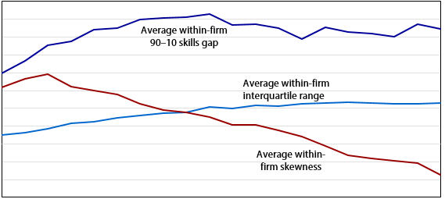
The Effects of Automation
Automation streamlines processes and tasks normally managed by middle management and supervisors
Process-oriented jobs are being replaced by automation and creating a skills gap in the modern workforce
Employees are now expected to have a wider range of skills and take on more responsibilities while receiving the same pay
Upper Management
Essential Staff
Supervisors and Leads

Slide 7
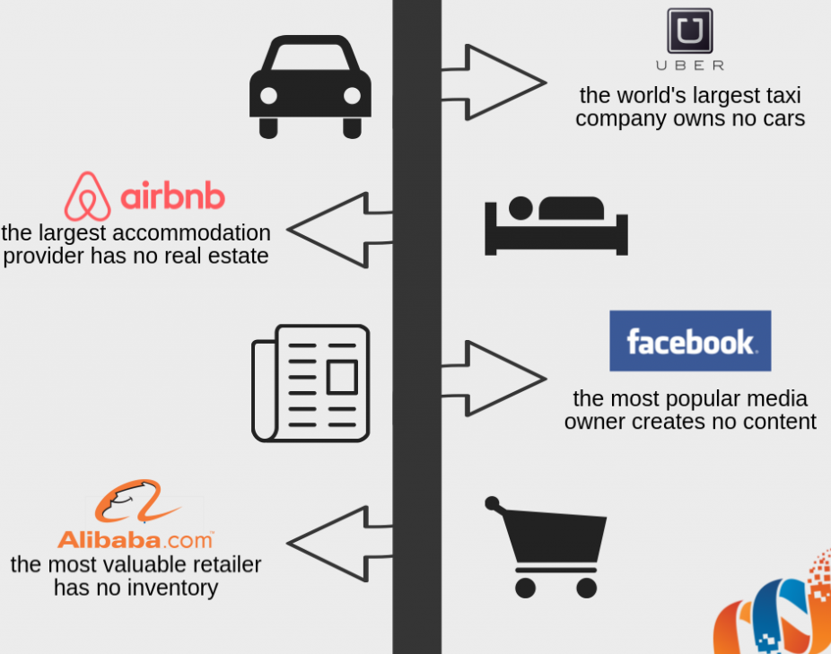
Operating Costs
Technology replaces the cost of maintaining a large workforce
Providers who rely on automation have less overhead costs
Almost no onboarding or HR costs

Slide 8
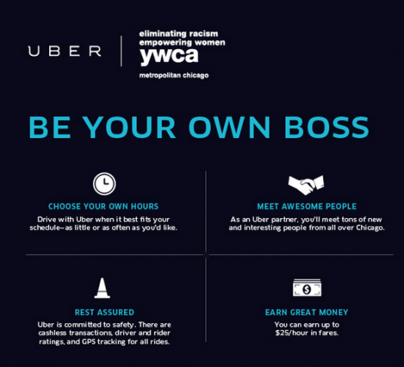
The Rise of the Gig Worker
Individuals can enter the market as independent entities
Operate as sole traders who advertise services through a third-party platform
Businesses are now in competition with people in the community, as well as each other

Slide 9
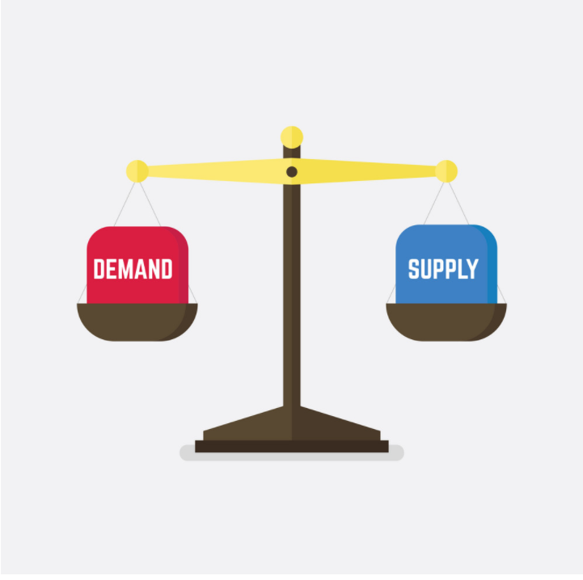
True Supply and Demand
Gig Economy platforms use technology to connect supply and demand, in real time
Minimise overhead costs, reduce expenditure and limit liability
Operate service-oriented businesses with larger profit margins and lower costs

Slide 10
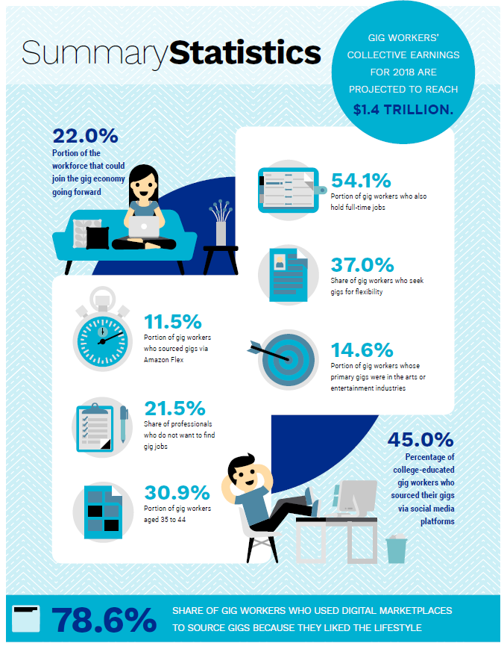
Gig Work, made easy…
Most Gig Work is centred around a single service and provides a second source of income
These services appeal to consumers with high need and frequent demand
Provide a low barrier of entry, for Gig Workers
Q: Won’t this lead to the same skills gap?

Slide 11
What about the worker?
Pros
Pick your own hours, be your own boss, work how you want to work
Cons
Responsible for your own benefits, no sick leave or maternity compensation, liable for your work, limited or no HR, unstructured professional development, few worker protections

Slide 12
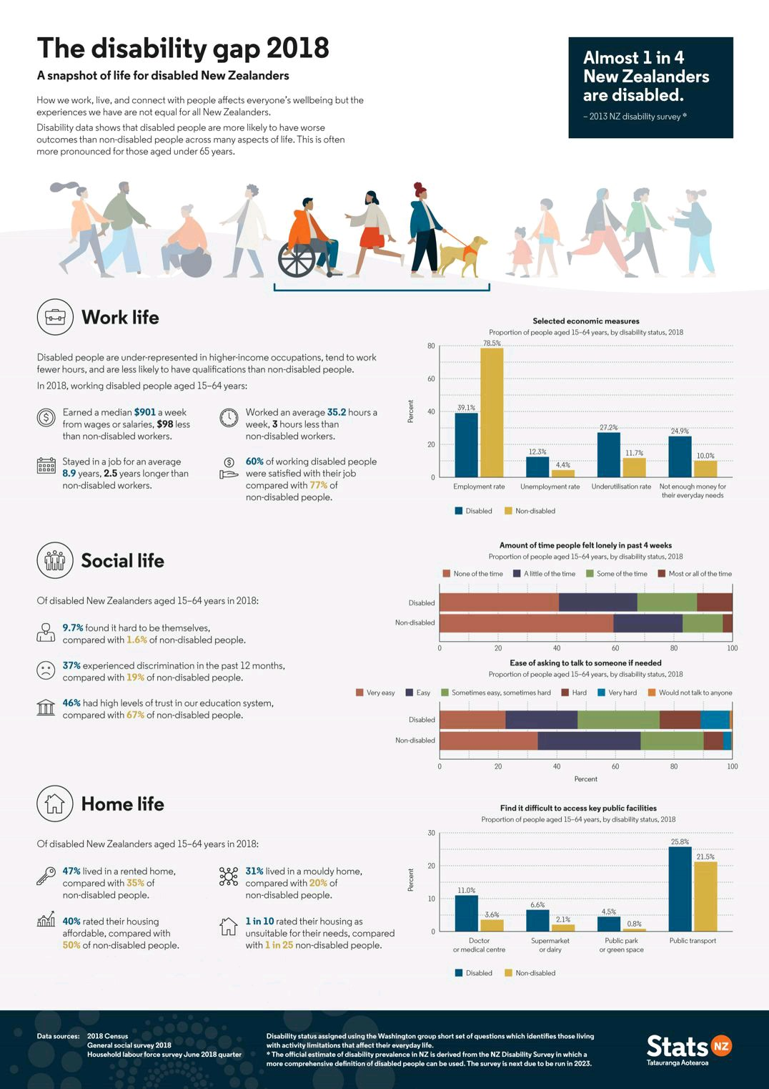
Why do we need to know this?
No market is immune to disruption
Would you rather be Uber or Corporate Cabs?
Gig Work isn’t going away
The Gig Economy generates more than $1.4 Trillion annually and is growing
Understanding is key to safeguarding
Individuals with invisible disabilities are more likely to participate in Gig Work, while individuals with physical disabilities are likely to be sidelined from Gig Work

Slide 13
What about the sector overall?
Individualised Funding is coming
There are more technology players entering the health space with ulterior motives
Connective and smart technologies are becoming necessities not luxuries

Slide 14
Questions?
Get in touch
Email: sherschberger@healthmetrics.co.nz
scott@skillet.co.nz
Phone: 021 0821 6308
LinkedIn: scott-herschberger

