Slide 1
Leadership for Service Transformation
NZDSN Leadership Forum|28 April 2021
Notes:
LOGAN
Survey
LISA
Intro to Humanly

Slide 2
The Journey Please see Interactionz for this resource.
Notes:
NELLIE

Slide 3
Enabling Good Lives Principles Please see Interactionz for this resource.
Notes:
NELLIE

Slide 4
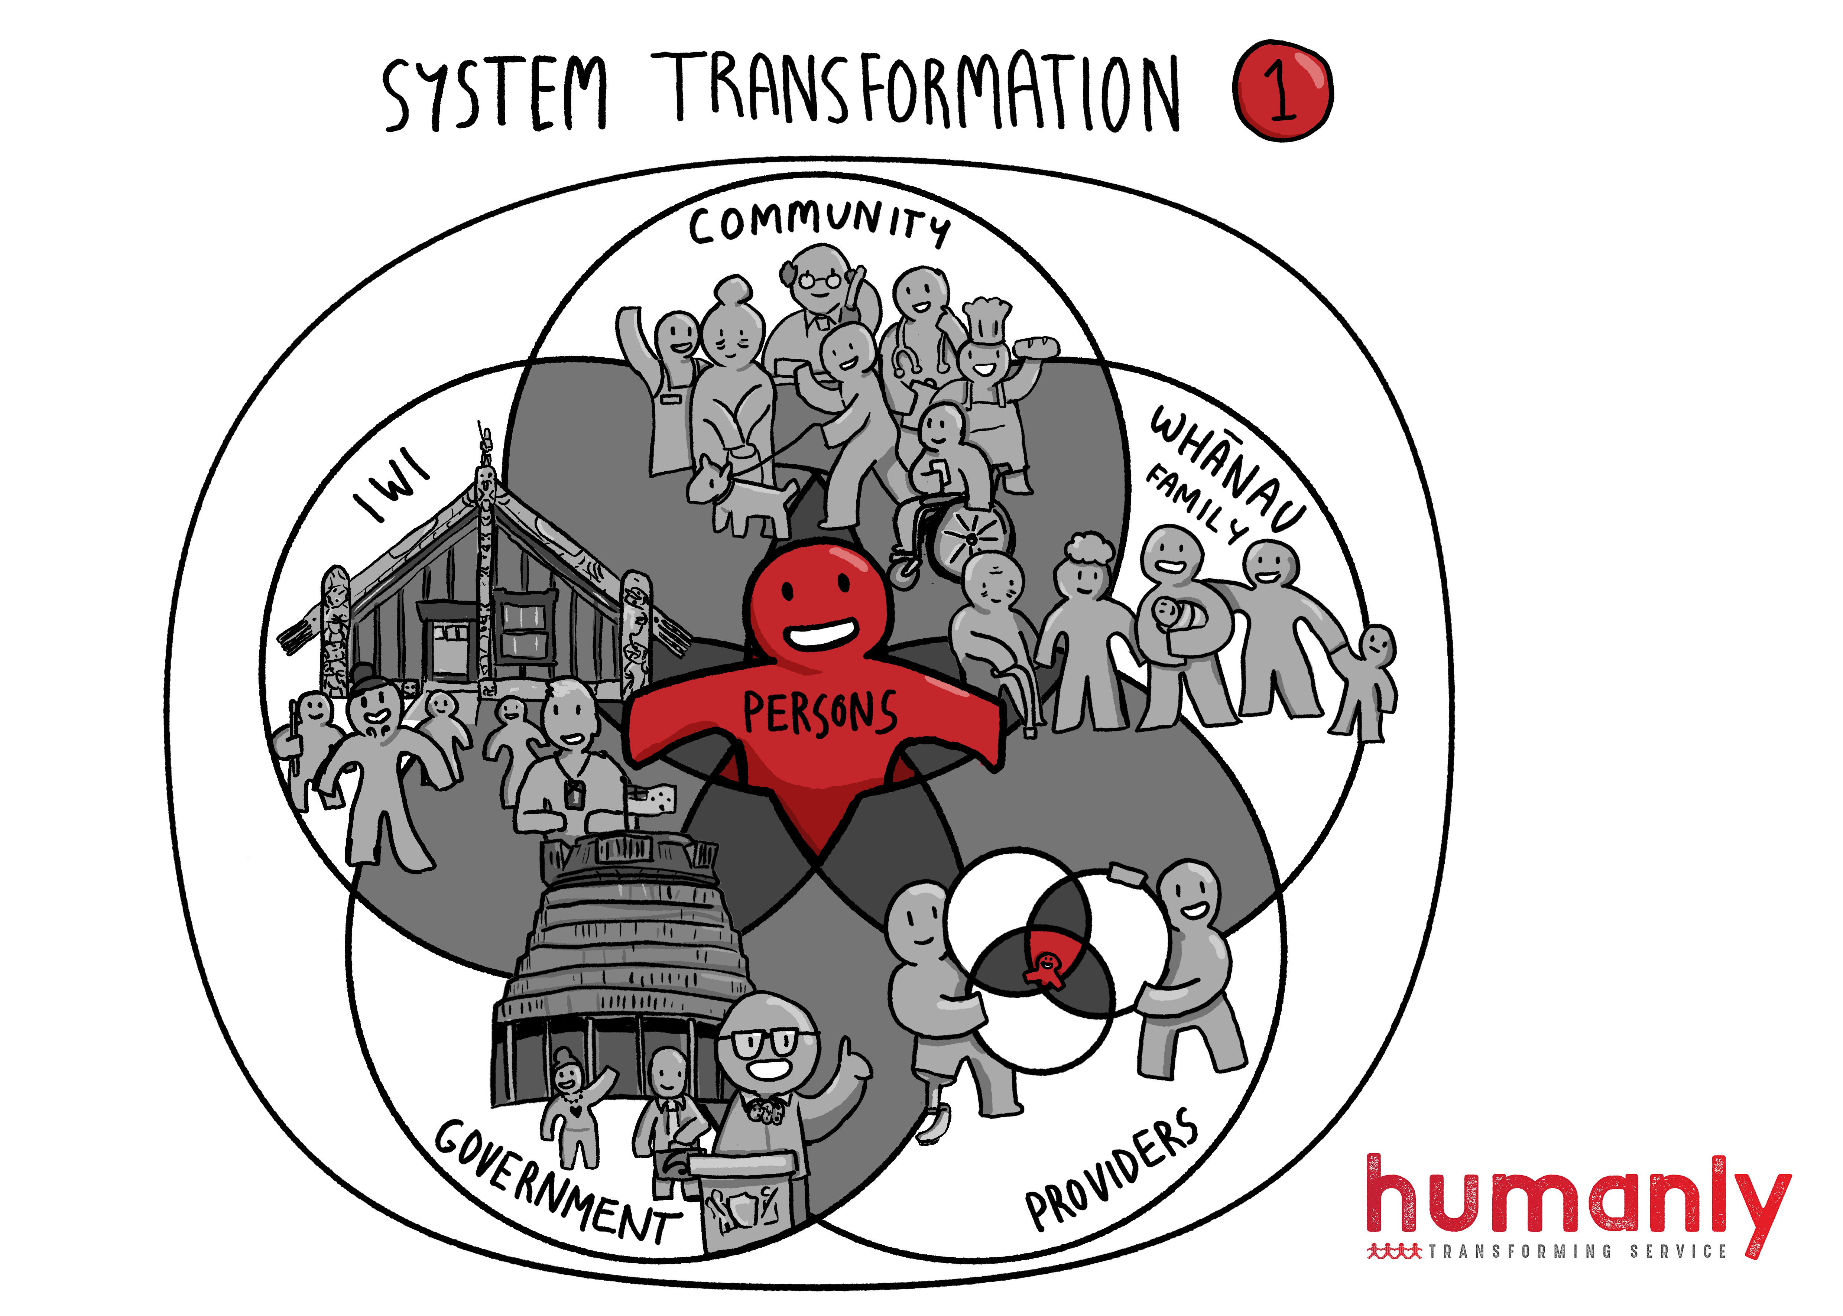
Notes:
NELLIE

Slide 5
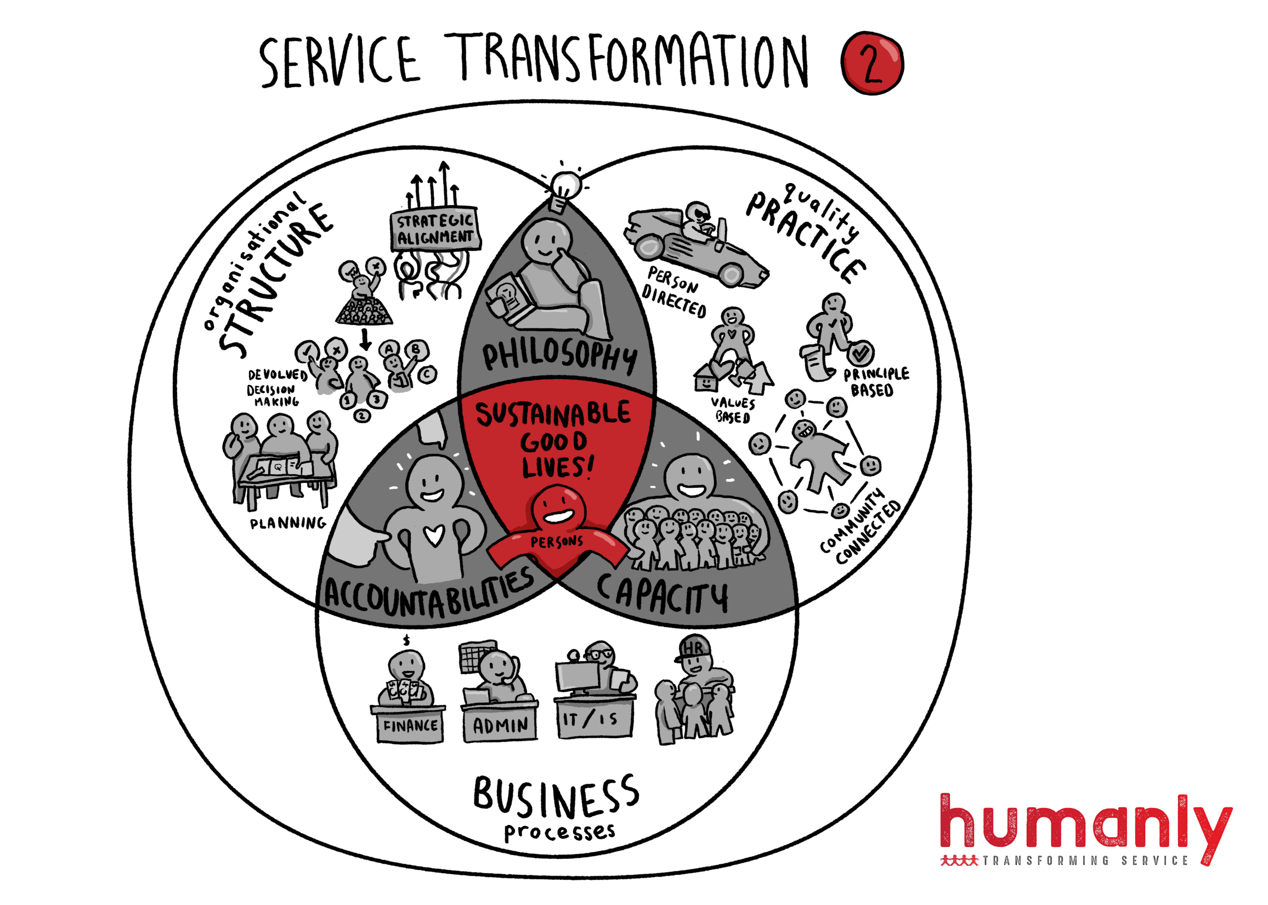
Notes:
NELLIE

Slide 6
Humanly Approach
WHY = Purpose of change
HOW = Change process
Notes:
NELLIE

Slide 7
Notes:
LISA

Slide 8
Notes:
LISA

Slide 9
Notes:
LISA

Slide 10
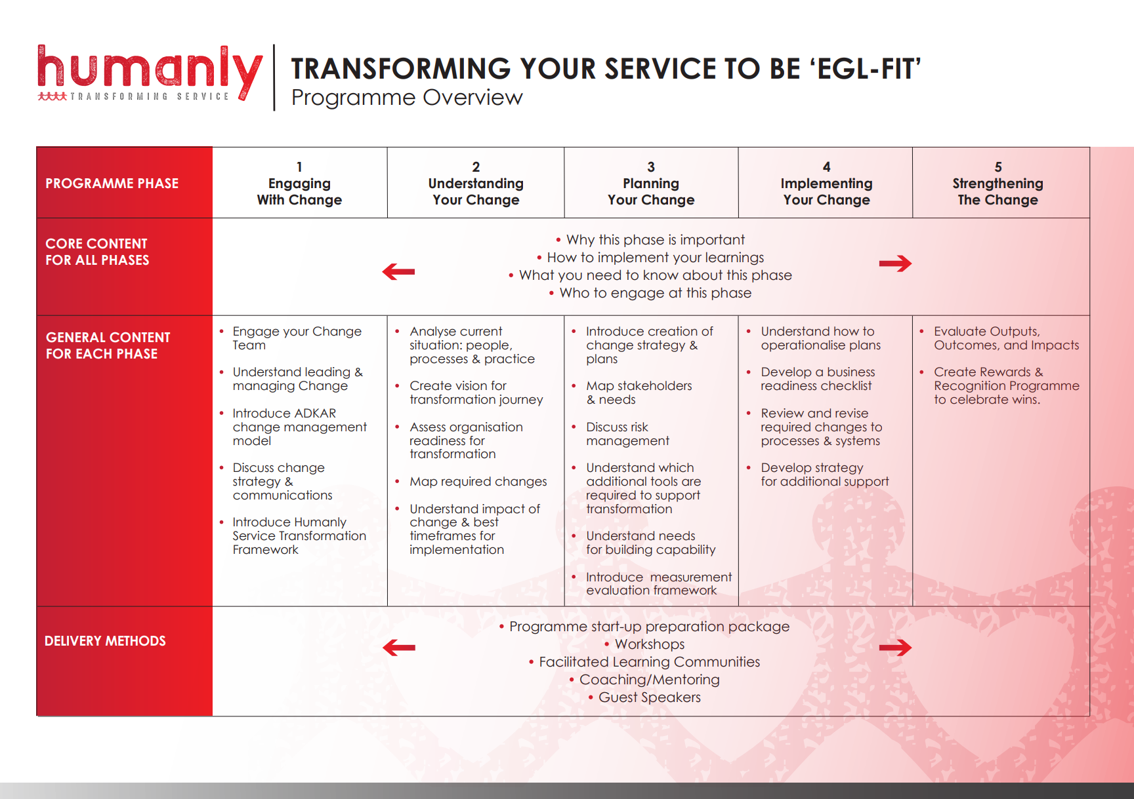
Notes:
LISA

Slide 11
Notes:
LISA

Slide 12
Notes:
LISA

Slide 13
Statistics
2 programmes
5 cohorts across 5 locations
28 Change Teams
139 participants
10 -12,000+ persons served by each participant organisation
With infinite indirect impact…
Notes:
LOGAN

Slide 14
What are three things that worked well for you at today's workshop?
Notes:
LOGAN

Slide 15
What else could we do to support your own learning and transformation journey?
Notes:
LOGAN

Slide 16
What is one thing you will do when you get back to work to apply the learning you've had today?
Notes:
LOGAN

Slide 17
Multi-Measure Reporting
Notes:
NELLIE

Slide 18
Notes:
NELLIE

Slide 19
Practice & Change Tools
55+ tools within a programme
Practice tools to improve & systemise service
Change tools to support an intentional process
Notes:
NELLIE

Slide 20
Notes:
LISA

Slide 21
Sustainable Service Transformation needs robust…
People
Plans
Tools
Notes:
LISA

Slide 22
Upcoming 4-Phase Programme
Starting from July 2021-June 2022
Expressions of Interest from Changemakers
20 Service Transformation Teams – July-December
20 Service Transformation Teams – January-June
Notes:
LISA

Slide 23
Humanly Offerings
Customised service transformation programmes & projects
Facilitated learning experiences & workshops
Coaching & mentoring
Notes:
LISA

Slide 24
Karen Beard-Greer Independent Living Services
It's just a series of compelling conversations,
to effect change through human engagement.
Notes:
LOGAN

Slide 25
Leadership for Service Transformation
NZDSN Leadership Forum|28 April 2021

