Slide 1
Safeguarding a Good Life
Sue Hobbs - Safeguarding Adults Consultant
Erika Butters - The Personal Advocacy and Safeguarding Adults Trust

Slide 2
Safeguarding a good life
Safeguarding framework – background and principles
How it will support disabled people to live the life they choose
Protecting and promoting the human rights of disabled people and adults at risk of abuse and neglect – Supported Decision Making
Factors that increase vulnerability
Who is at risk and in need of safeguarding support
The different types of abuse of disabled people
How to initiate safeguarding adults’ procedures when a disabled person is at risk of or experiencing compromised human rights, abuse and neglect.

Slide 3
Join at vevox.app
Or search Vevox in the app store
ID: 115-318-999
Join: vevox.app ID: 115-318-999

Slide 4
What learning outcome do you want to achieve most today? Choose two:

Slide 5
What learning outcome do you want most from this Workshop? To be able to understand and describe:
POLL OPEN
80
Vote for up to 2 choices
1
The Safeguarding framework – Background, Definitions and Principles
36.84%
2
How the framework will support disabled people to live the life they choose
39.47%
3
The spectrum of safeguards needed to effectively respond, including supported decision making
39.47%
4
Basic human rights to consent and decision making
7.89%
5
Factors that increase vulnerability
13.16%
6
Who is at risk and identifying the need for safeguarding support
5.26%
7
How legislation affects your safeguarding responsibilities
18.42%
8
The different types of abuse experienced by disabled people
15.79%
9
The SAFA multi-agency, multi-disciplinary approach for safeguarding people at risk of experiencing abuse and neglect.
23.68%
(% = Percentage of Voters)
Join: vevox.app ID: 115-318-999
Vote Trigger

Slide 6
What is Safeguarding?
80
Enter Text and Press Send
Join: vevox.app ID: 115-318-999
Vote Trigger

Slide 7
What is Safeguarding?
Safeguarding is a range of activities and responses that promote and protect human rights, health, wellbeing and culture; and prevent or reduce harm, abuse and neglect.

Slide 8
Safeguarding Framework The Framework’s spectrum of safeguards will enable disabled people to make informed choices, including taking risks and having opportunities like other people

Slide 9
Decision Making, Choice & Control
Citizenship & Quality of Life
Safety &
Wellbeing
THE PERSON
(and their culture)
HUMAN RIGHTS
PROMOTE
PROTECT
ENHANCE

Slide 10
ENHANCE
PROMOTE
Decision Making, Choice & Control
PROTECT
Citizenship & Quality of Life
THE PERSON
(and their culture)
Safety &
Wellbeing
HUMAN RIGHTS
PERSONAL
RELATIONSHIPS
(family/whanau/other)
COMMUNITY
COMMUNITY AND DISABILITY SERVICES
SYSTEMS

Slide 11
Continuum of Safeguarding
Education and Training
Supported Decision Making
Independent Advocacy
Coordinated Interagency Safeguarding Adults Response

Slide 12
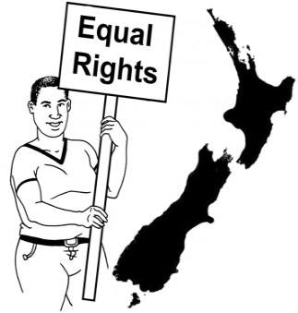
Article 12 (CRPD)
The United Nations Convention on the Rights of Persons with Disabilities (CRPD)
Article 12 – Equal recognition before the law
Requires State Parties to replace substituted decision making regimes with supported decision making.

Slide 13
What is Supported Decision Making?
Support that helps an individual with a decision making impairment make their own decisions,
by using supporters to: (such as friends, family, advocates, professionals, and other people he/she trusts)
help understand the decision and choices
ask questions
receive information in a way he/she understands; and
communicate his/her own decisions to others.

Slide 14
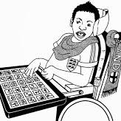
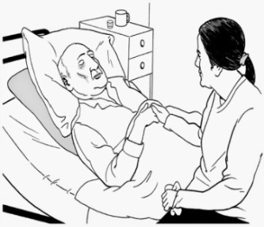
Who may need SDM support?
People with decision making impairment
This may be people with:
dementia
acquired brain injuries
neurodisabilities
experience of mental illness
other kinds of neurological or physical
impairments or health conditions affecting their decision making abilities.

Slide 15
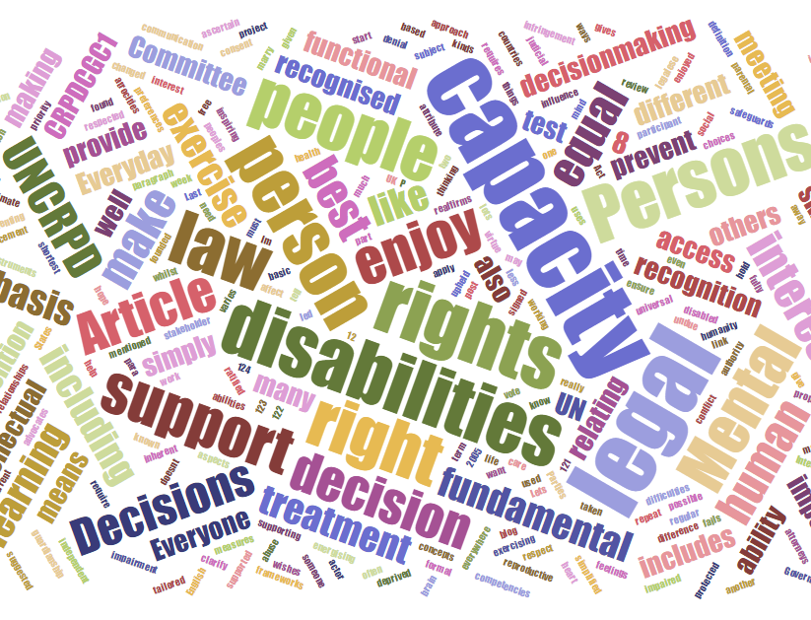
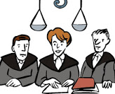
Legal Capacity and Mental Capacity
Legal capacity is:
about having the ability to make decisions and be recognised as capable of making decisions with legal effect
an inherent right owed to everyone.
Mental capacity is:
relates to a person’s decision making skills which varies from person to person and decision to decision (can often be subjective depending on how it is measured).
Supported decision making helps people to exercise their legal capacity

Slide 16
Rethink Capacity and Assessments
People may have “capacity” to:
Make some decisions but not others
Make decisions sometimes but not others
Make decisions if they get help understanding the decision to be made.

Slide 17
The Protection of Personal and Property Rights Act 1988 (PPPR Act)
Property Manager
or
Property Administrator
Personal Orders
Enduring Power of Attorney
Person
Welfare Guardian

Slide 18
Supported Decision Making Steps

Slide 19
Supported Decision Making Steps
Describe the decision
Accessing easy to understand information
Exploring options
Consider the consequences/ pros and cons
Making decisions
Acting on decisions
Review/evaluate decisions.
Adapted from IHC Supporting Decision-Making : A Guide for Supporters of People with an Intellectual Disability

Slide 20
Recognising vulnerability and being responsive to people’s needs
Understand any limitations the person experiences in their:
ability to safeguard themselves
self-determination
ability to effectively ensure their rights, wishes, preferences and decisions are enacted
capacity to make themselves understood by others
capacity to make decisions about their lives and communicate decisions to others
capacity and likelihood, when their rights are compromised, of speaking up.

Slide 21
Who is a
Vulnerable Adult / Adult at Risk?
Has care and/or support needs and
Is experiencing (or at risk of) harm, abuse and neglect and
Because of their care and/or support needs, is unable to protect her/himself against the harm, abuse or neglect (or risk of it)

Slide 22
Adults at Risk form an invisible community

Slide 23
Join at vevox.app
Or search Vevox in the app store
ID: 115-318-999
Join: vevox.app ID: 115-318-999

Slide 24
What is our current Safeguarding Legislation?
120
Enter Text and Press Send
Join: vevox.app ID: 115-318-999
Vote Trigger

Slide 25
Abuse What are the different types of abuse experienced by disabled people and Adults at Risk?

Slide 26
Case Scenarios

Slide 27
Scenario questions:
Is anyone not living their good life, and why?
Are anyone’s rights being compromised?
Is anyone ‘vulnerable’ in this situation and why?
Are there any signs that could indicate that harm, abuse, neglect is happening?
Is anyone experiencing/risk of abuse – what type of abuse?
What are the strengths and protective factors?
What safeguards need to be put in place to ensure the person is living the life they choose safe from harm?
Is the person an adult at risk?

Slide 28
What is ‘Safeguarding Adults from Abuse’?
SAFA is an integrated multi-agency and multidisciplinary approach to preventing, recognising and responding to harm, abuse and neglect of adults at risk.
The Safeguarding Adults approach aims to provide a range of responses and activities that promote and protect the human rights, health, wellbeing and safety of an adult in need of safeguarding.

Slide 29
Safeguarding a Good Life
Safeguarding framework – background and principles
How the safeguarding framework will support disabled people to live the life they choose
Protecting and promoting the human rights of disabled people and adults at risk of abuse and neglect
Factors that increase vulnerability
Who is at risk and in need of safeguarding support
The different types of abuse of disabled people
How to initiate safeguarding adults’ procedures when a disabled person is at risk of or experiencing compromised human rights, abuse and neglect.

Slide 30
Join at vevox.app
Or search Vevox in the app store
ID: 115-318-999
Join: vevox.app ID: 115-318-999

Slide 31
What learning outcome do you feel you achieved the most? (Choose two):

Slide 32
What learning outcome do you feel you achieved the most? To be able to understand and describe:
POLL OPEN
80
Vote for up to 2 choices
1
The Safeguarding framework – Background, Definitions and Principles
30.95%
2
How the framework will support disabled people to live the life they choose
38.1%
3
The spectrum of safeguards needed to effectively respond, including supported decision making
50%
4
Basic human rights to consent and decision making
9.52%
5
Factors that increase vulnerability
2.38%
6
Who is at risk and identifying the need for safeguarding support
11.9%
7
How legislation affects your safeguarding responsibilities
11.9%
8
The different types of abuse experienced by disabled people
23.81%
9
The SAFA multi-agency, multi-disciplinary approach for safeguarding people at risk of experiencing abuse and neglect.
21.43%
(% = Percentage of Voters)
Join: vevox.app ID: 115-318-999
Vote Trigger

Slide 33
What learning outcome do you want most from this Workshop? To be able to understand and describe:
Join: vevox.app ID: 115-318-999
Vote for up to 2 choices
1
The Safeguarding framework – Background, Definitions and Principles
31.0%
36.8%
2
How the framework will support disabled people to live the life they choose
38.1%
39.5%
3
The spectrum of safeguards needed to effectively respond, including supported decision making
39.5%
50.0%
4
Basic human rights to consent and decision making
7.9%
9.5%
5
Factors that increase vulnerability
2.4%
13.2%
6
Who is at risk and identifying the need for safeguarding support
5.3%
11.9%
7
How legislation affects your safeguarding responsibilities
11.9%
18.4%
8
The different types of abuse experienced by disabled people
15.8%
23.8%
9
The SAFA multi-agency, multi-disciplinary approach for safeguarding people at risk of experiencing abuse and neglect.
21.4%
23.7%
1st Vote
2nd Vote
(% = Percentage of Voters)
Vote Trigger

Slide 34
What is Safeguarding?
80
Enter Text and Press Send
Join: vevox.app ID: 115-318-999
Vote Trigger

Slide 35
Thank You! Questions and evaluation

