Slide 1



Preventing Violent Extremist Grooming
Supporting Providers to overcome the threat to disabled people in Aotearoa.

Slide 2



Slide 4



NZSIS
STRATEGY
2024-2029
Keeping
New Zealand and
New Zealanders
safe and secure
Our
Mission
Our
Services
Security
Intelligence
Foreign
Intelligence
Protective
Security
Our
Impacts
Countering
violent extremism
and terrorism
Contributing
to a secure,
prosperous and
resilient Pacific
Countering
espionage and
foreign interference
Protecting
people, information
and assets

Slide 5
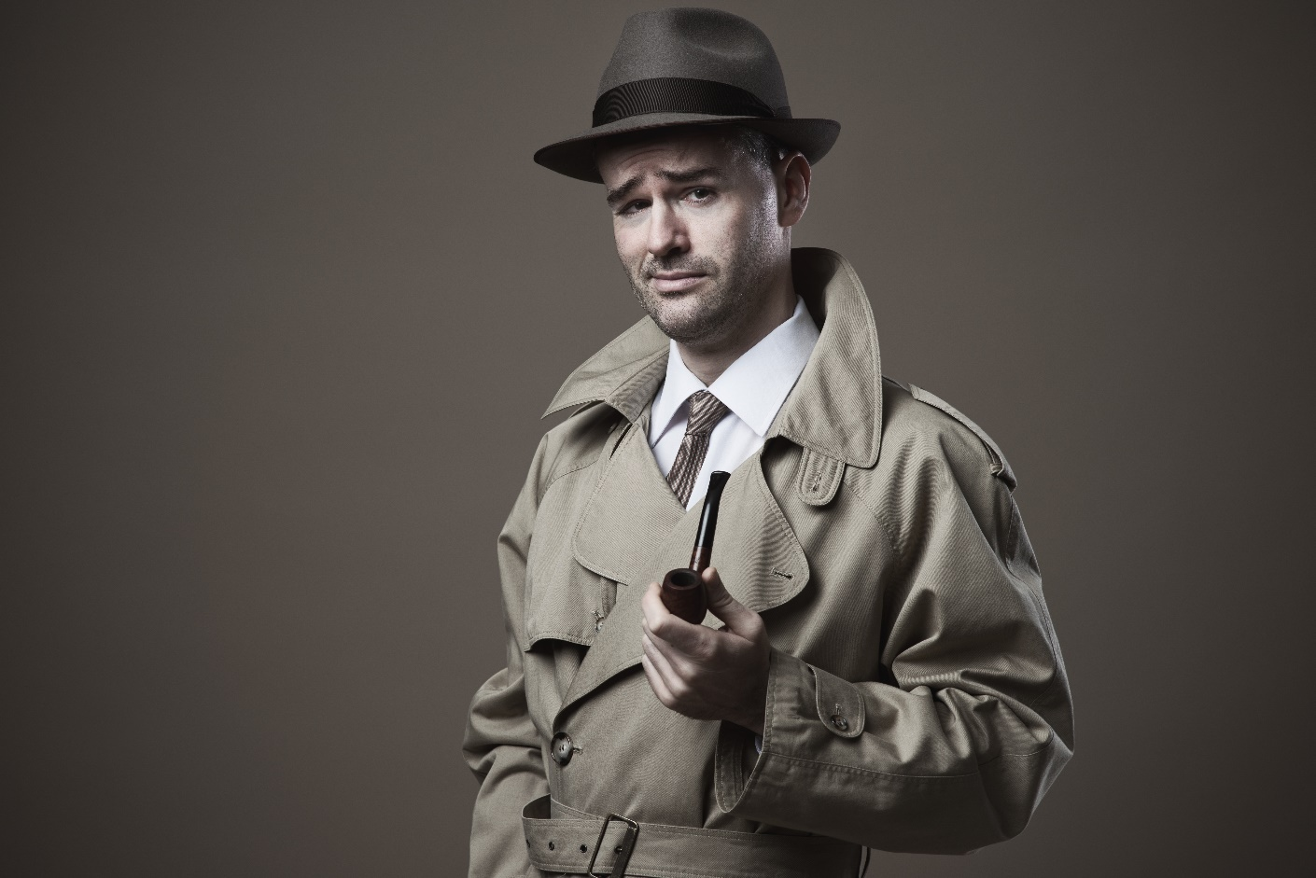
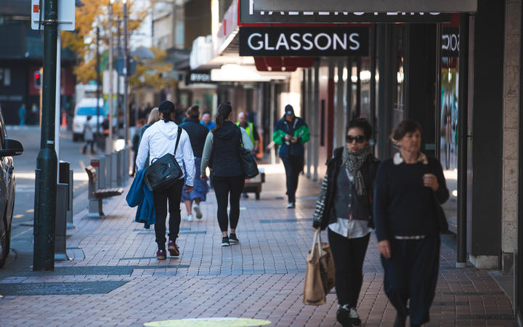
Myth vs Reality
We’re not reading your emails
We’re not listening to your phone calls
We’re not monitoring your Google searches
We don’t/can’t arrest anyone
Image source: RNZ

Slide 6

The scale of extremism
Extremism comes in different forms
^{Extremism: views on the fringe}
Violent extremism: the belief in violence
Terrorism refers to the act of violence
Non-violent forms of extremism, however objectionable, lie outside the purpose of the guide and outside NZSIS’s areas of focus.

Slide 7
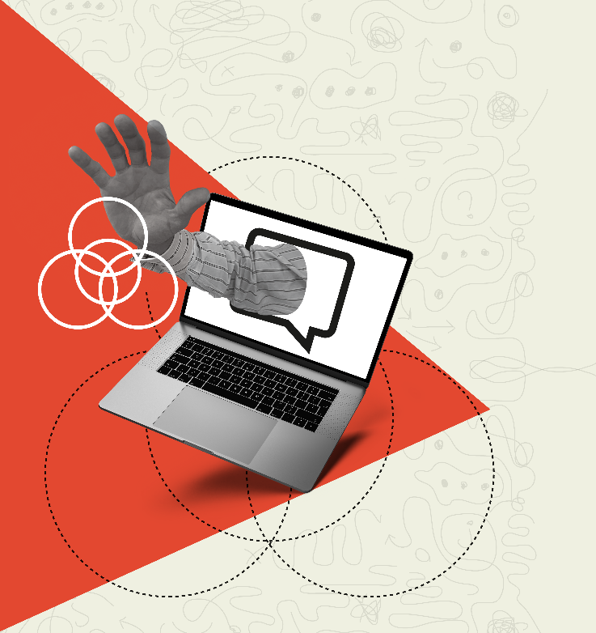
Mixed, Unstable and Unclear
Ideologies (MUU)
Violent extremism and terrorism
Identity-Motivated
Violent Extremism (IMVE)
Politically-Motivated
Violent Extremism (PMVE)
Faith-Motivated
Violent Extremism (IMVE)

Slide 8
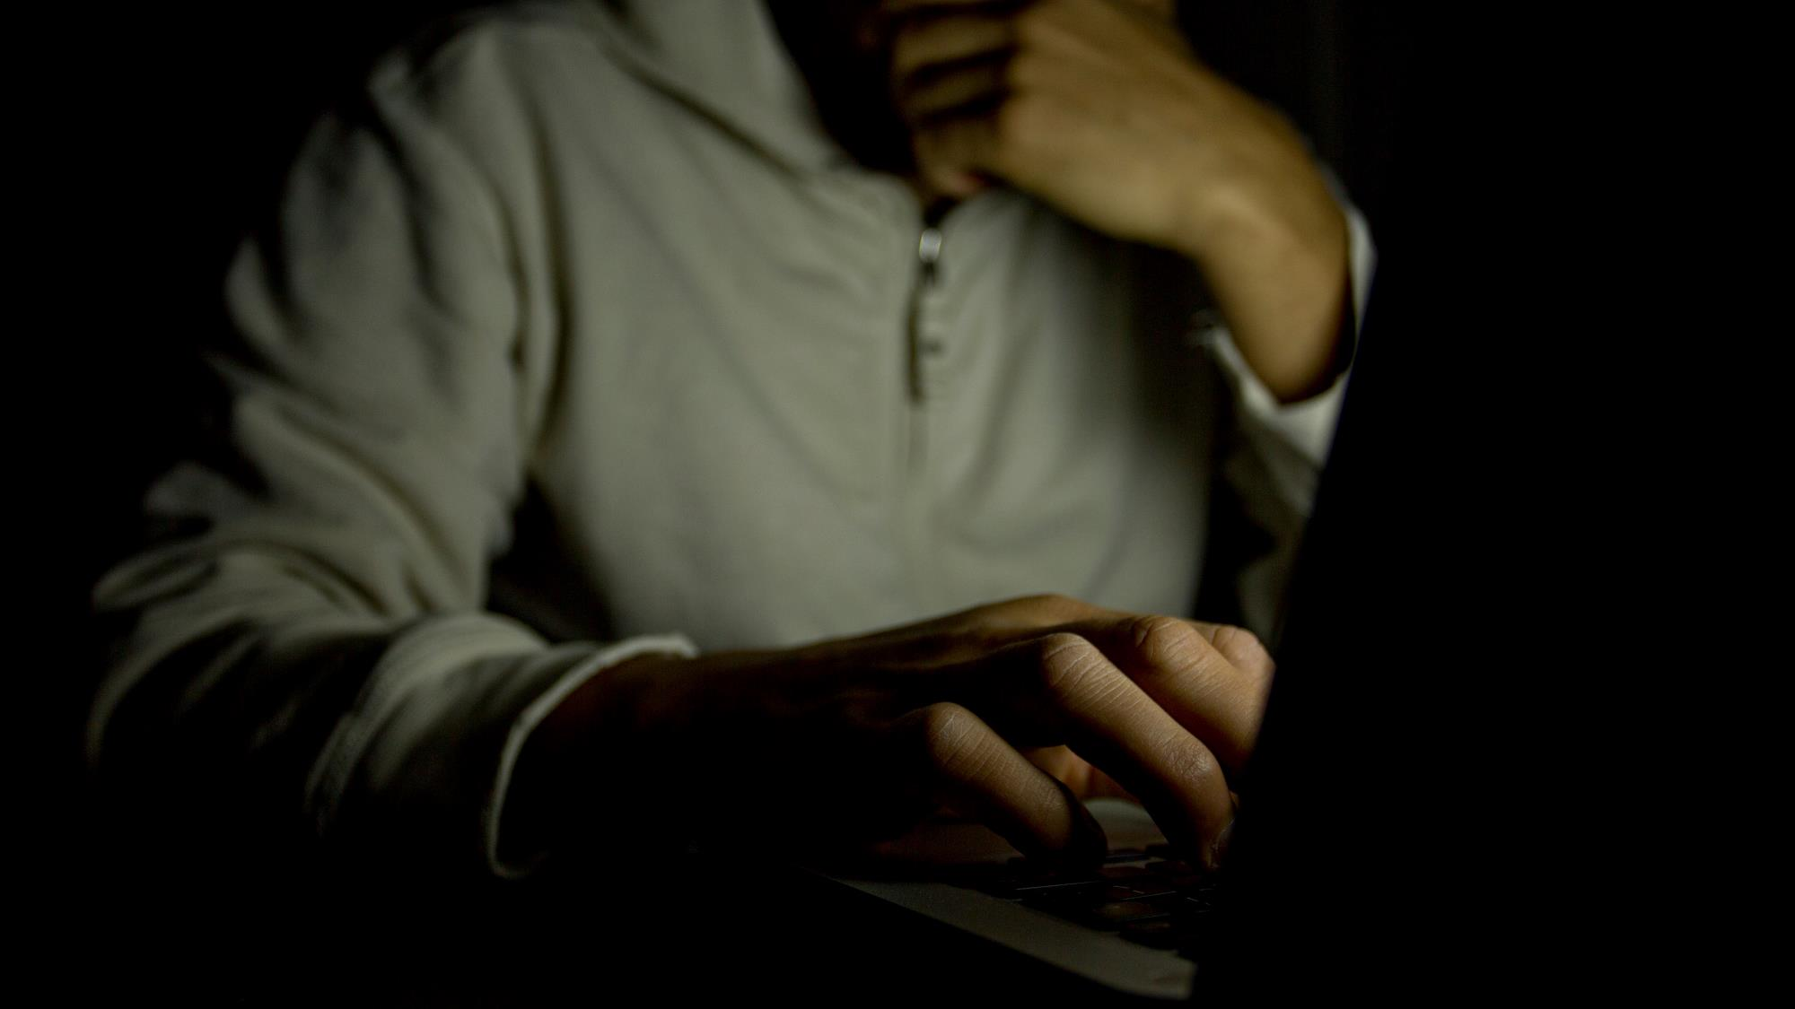

UNCLASSIFIED
Kia mataara ki ngā tohu
Know the signs
A guide for identifying signs of violent extremism.
UNCLASSIFIED
8

Slide 9

^{Now more than}
^{ever, we need to}
^{work together}
^{to protect}
^{each other.}

Slide 10
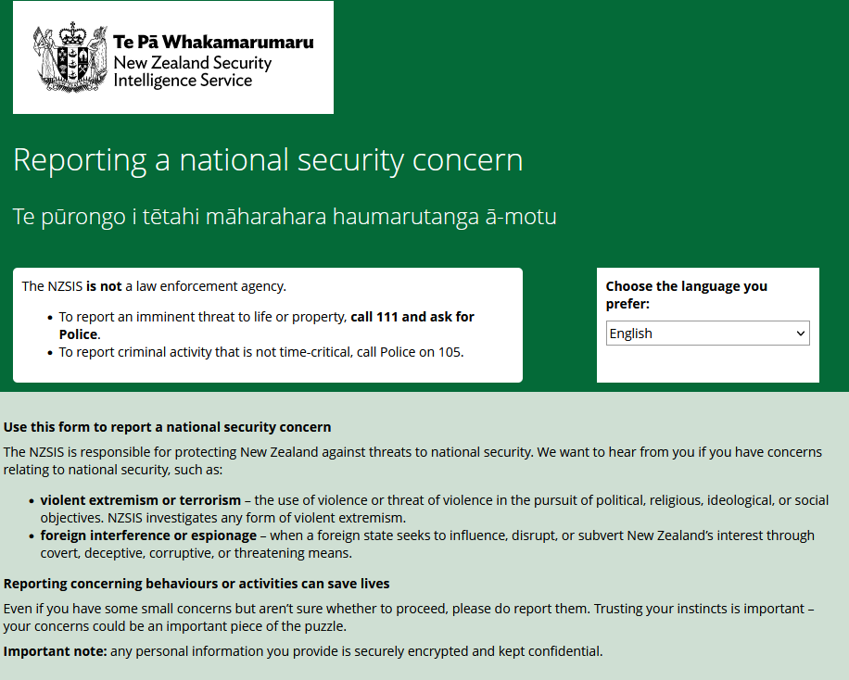
Reporting concerns with NZSIS

Slide 11
National security leads
A lead is an initial piece of information that may indicate a threat to national security.
For NZSIS to be involved, the lead must be relevant to NZ and be connected to an issue of national security concern.
If this information does not meet our threshold, then it can be passed to other agencies, such as NZ Police

Slide 12
In an emergency, phone 111 immediately. Also phone 111 immediately if the information is time-critical, such
as if an attack is likely to happen very soon.
If the information is not time critical, you can report suspicious behaviour in one of the following ways.
^{Tell NZSIS}
Complete an online form confidentially on our website:
^{www.nzsis.govt.nz}
^{Tell the Police}
^{You can either:}
complete an online report at 105.police.govt.nz, or
call their non emergency number 105.
^{Tell Crimestoppers}
Phone Crimestoppers anonymously on 0800 555 111, or submit an online report at www.crimestoppers-nz.org
^{Kia mataara}
^{ki ngā tohu}
^{Know the signs}

Slide 13
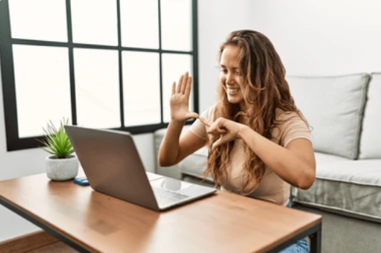
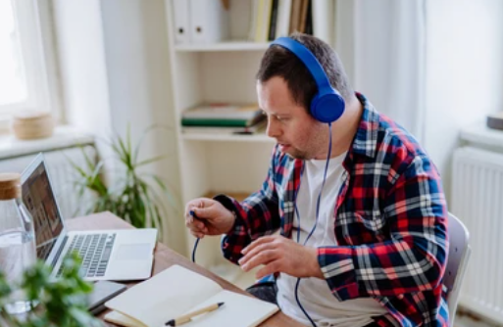
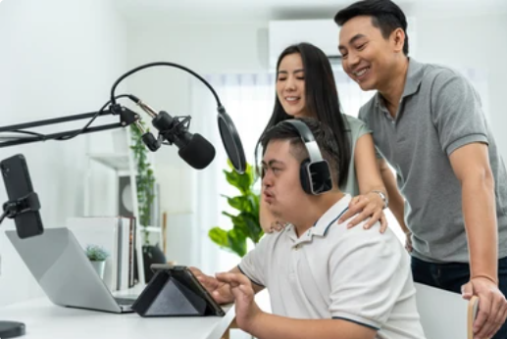
Why is this important to our Community

Slide 14
Radicalisation and why
our Population are at risk
Isolated and lonely.
Unhappy about themselves
Embarrassed or judged about their culture, gender, religion, disability or race.
Struggle with depression / Mental Health challenges.
Bullied or treated badly by other people or by society.
Angry at other people or the government (a system has failed them).
Easily confused about what they are doing.
OUR POPULATION TICK TOO MANY OF THESE BOXES

Slide 15
Sector support to help counter the risk?
Education and Awareness:
  Provide education on the risks of online grooming and how to recognize the signs.
Workshops for Support Staff:
  Training for support staff who work with disabled individuals can raise awareness about online harms and grooming.
Online Resources for disabled people to improve internet literacy
Support Services being involved to support from senior level
Monitoring changes in behaviour for those at High-Risk
Safety Cards:
  Both for guides to staying safe on popular online platforms and simple frameworks for support staff to identify changes in presentation and identifying warning signs.
Community Support:
  Create a supportive community environment where disabled individuals can share their experiences.

Slide 16



Partnered with Carers NZ & Autism NZ

Slide 17
Video Link
https://youtu.be/0yylKLSP9uM

Slide 18
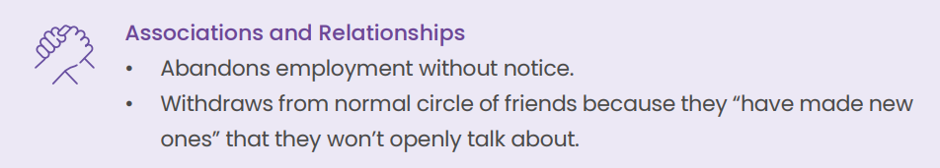
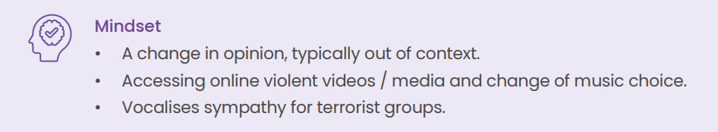
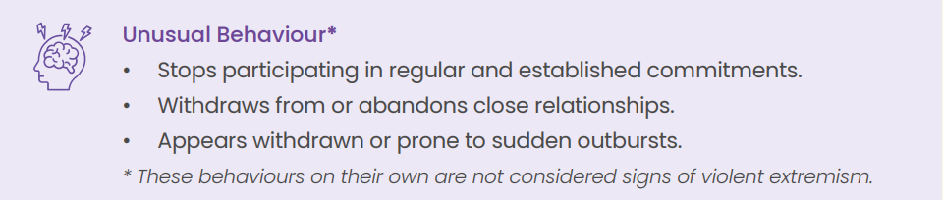
Know the Signs

Slide 19
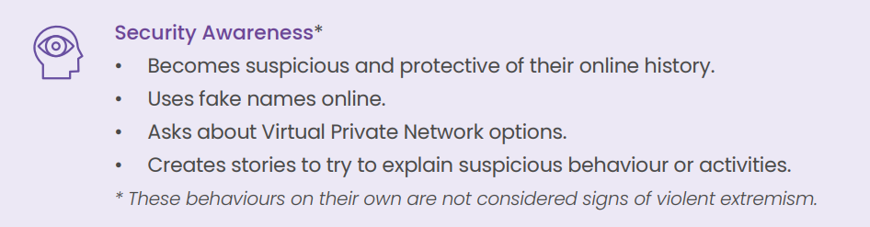
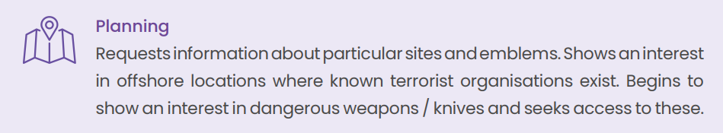
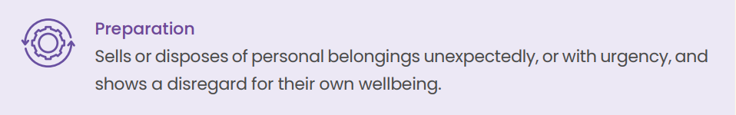
Know the Signs

Slide 20

Support Providers

Slide 21
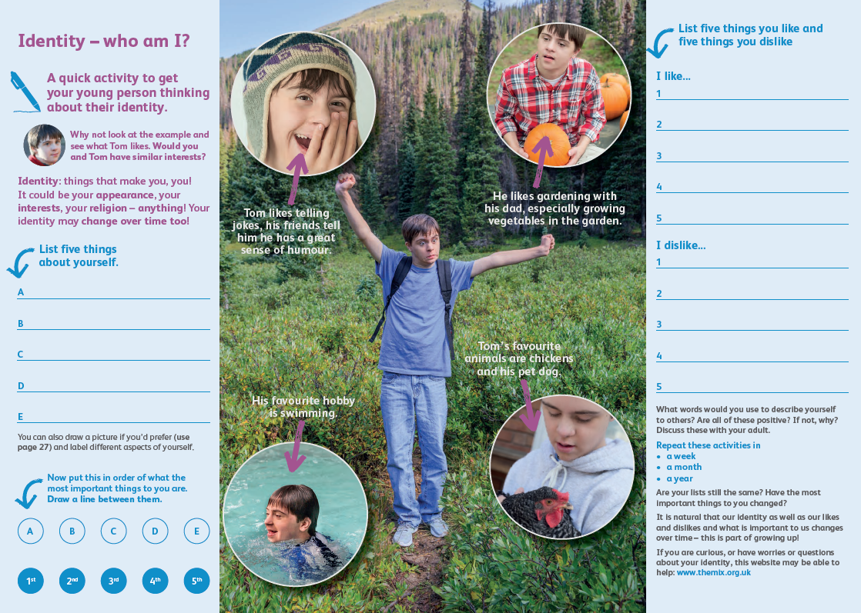
‘This is me” Identity Profile

Slide 22
Risk Framework - with a difference

Slide 23
Likelihood – probability of risk
Rare: Person doesn't access online content and natural networks are well documented and known to whanau and support staff
Unlikely : Person accesses online content as part of entertainment with no social media engagement and/or with supervision/support only
Possible: Person accesses the internet without support, limited to online videos of a non-violent nature
Likely : Person accesses online content, social media and occasionally meets people in chat rooms or exchanges comments with strangers online, unsupervised.
Highly Likely: Person accesses online content, frequents chat rooms and has dynamic relationships with people online, unsupervised.

Slide 24
Presentation :
Considering the warning signs / demonstration of current and/or changes a person portrays
Very Low - Person has no indication of any vocalising of sympathy towards a group or movement.
Low - Person displays 1 or 2 of the sign typically, but no change to behaviour noted.
Moderate - Person displays a change in 2+ warning signs.
High - Person displays changes to 3+ warning signs and vocalises sympathy towards a movement / political stance / religion which is notably different to their historical beliefs or passions.
Very High - Person displays changes to 3+ warning signs AND in addition of High above, includes signs of planning and gathering of dangerous weapons.

Slide 25
Risk Framework - with a difference

Slide 26

What’s Next?
NZDSN support
Regional Forums
Explore Lead Residential Specialists

