Slide 1
Moving forward with Volition:
The tool for Supported Decision Making you
always knew you needed

Slide 2
Supported
Decision
Making
(SDM)
Challenge
For providers
For disabled people
For whānau and other supporters
Innovation
Results

Slide 3
Supported
Decision
Making
(SDM)
Challenges
For providers
For disabled people
For whānau and other supporters
Innovation
Results

Slide 4
Supported
Decision
Making
(SDM)
Challenges
For providers
For disabled people
For whānau and other supporters
Innovation
Volition
Results
?

Slide 5
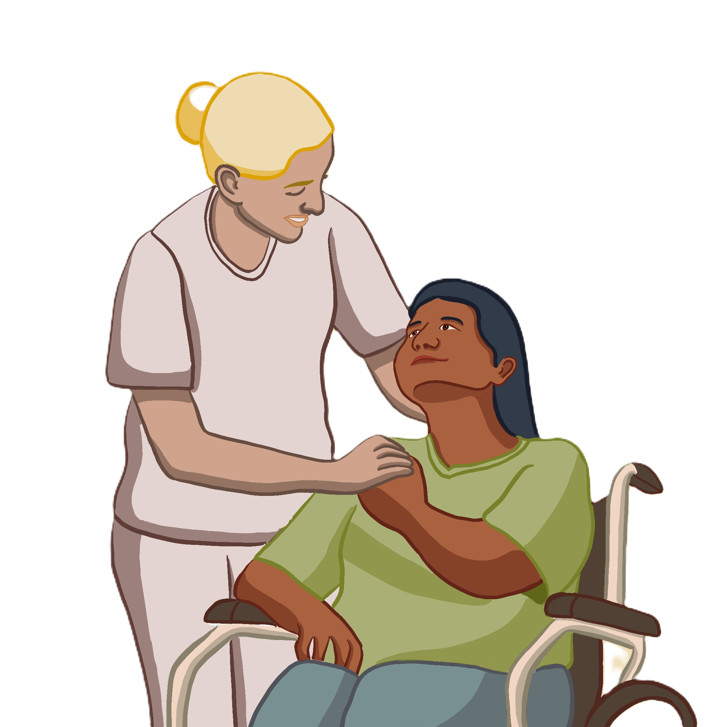
Challenges
For providers
Notes:
Person-centred and directed services.
- Validation conversations – you all told me that… this was hard.
FTEs to interview clients. Info collected only as often as they collect it – yearly, quarterly, monthly. Inadvertently filtered and adapted.

Slide 6
Challenges
For providers
Notes:
36% turnover rate

Slide 7
Challenges
For providers
Notes:
Person directed services that follow EGL principles, conmpetitive market.

Slide 8
Challenges
For providers
For disabled people
Notes:
Obvious – but decisions made for them instead of by them, lack autonomy, need to repeat thmesevls over and over again when you think abou that 36% turnover rate.
Law Commission’s review – but human rights sit above that, not dependent on Law Commission’s recomendatoins

Slide 9
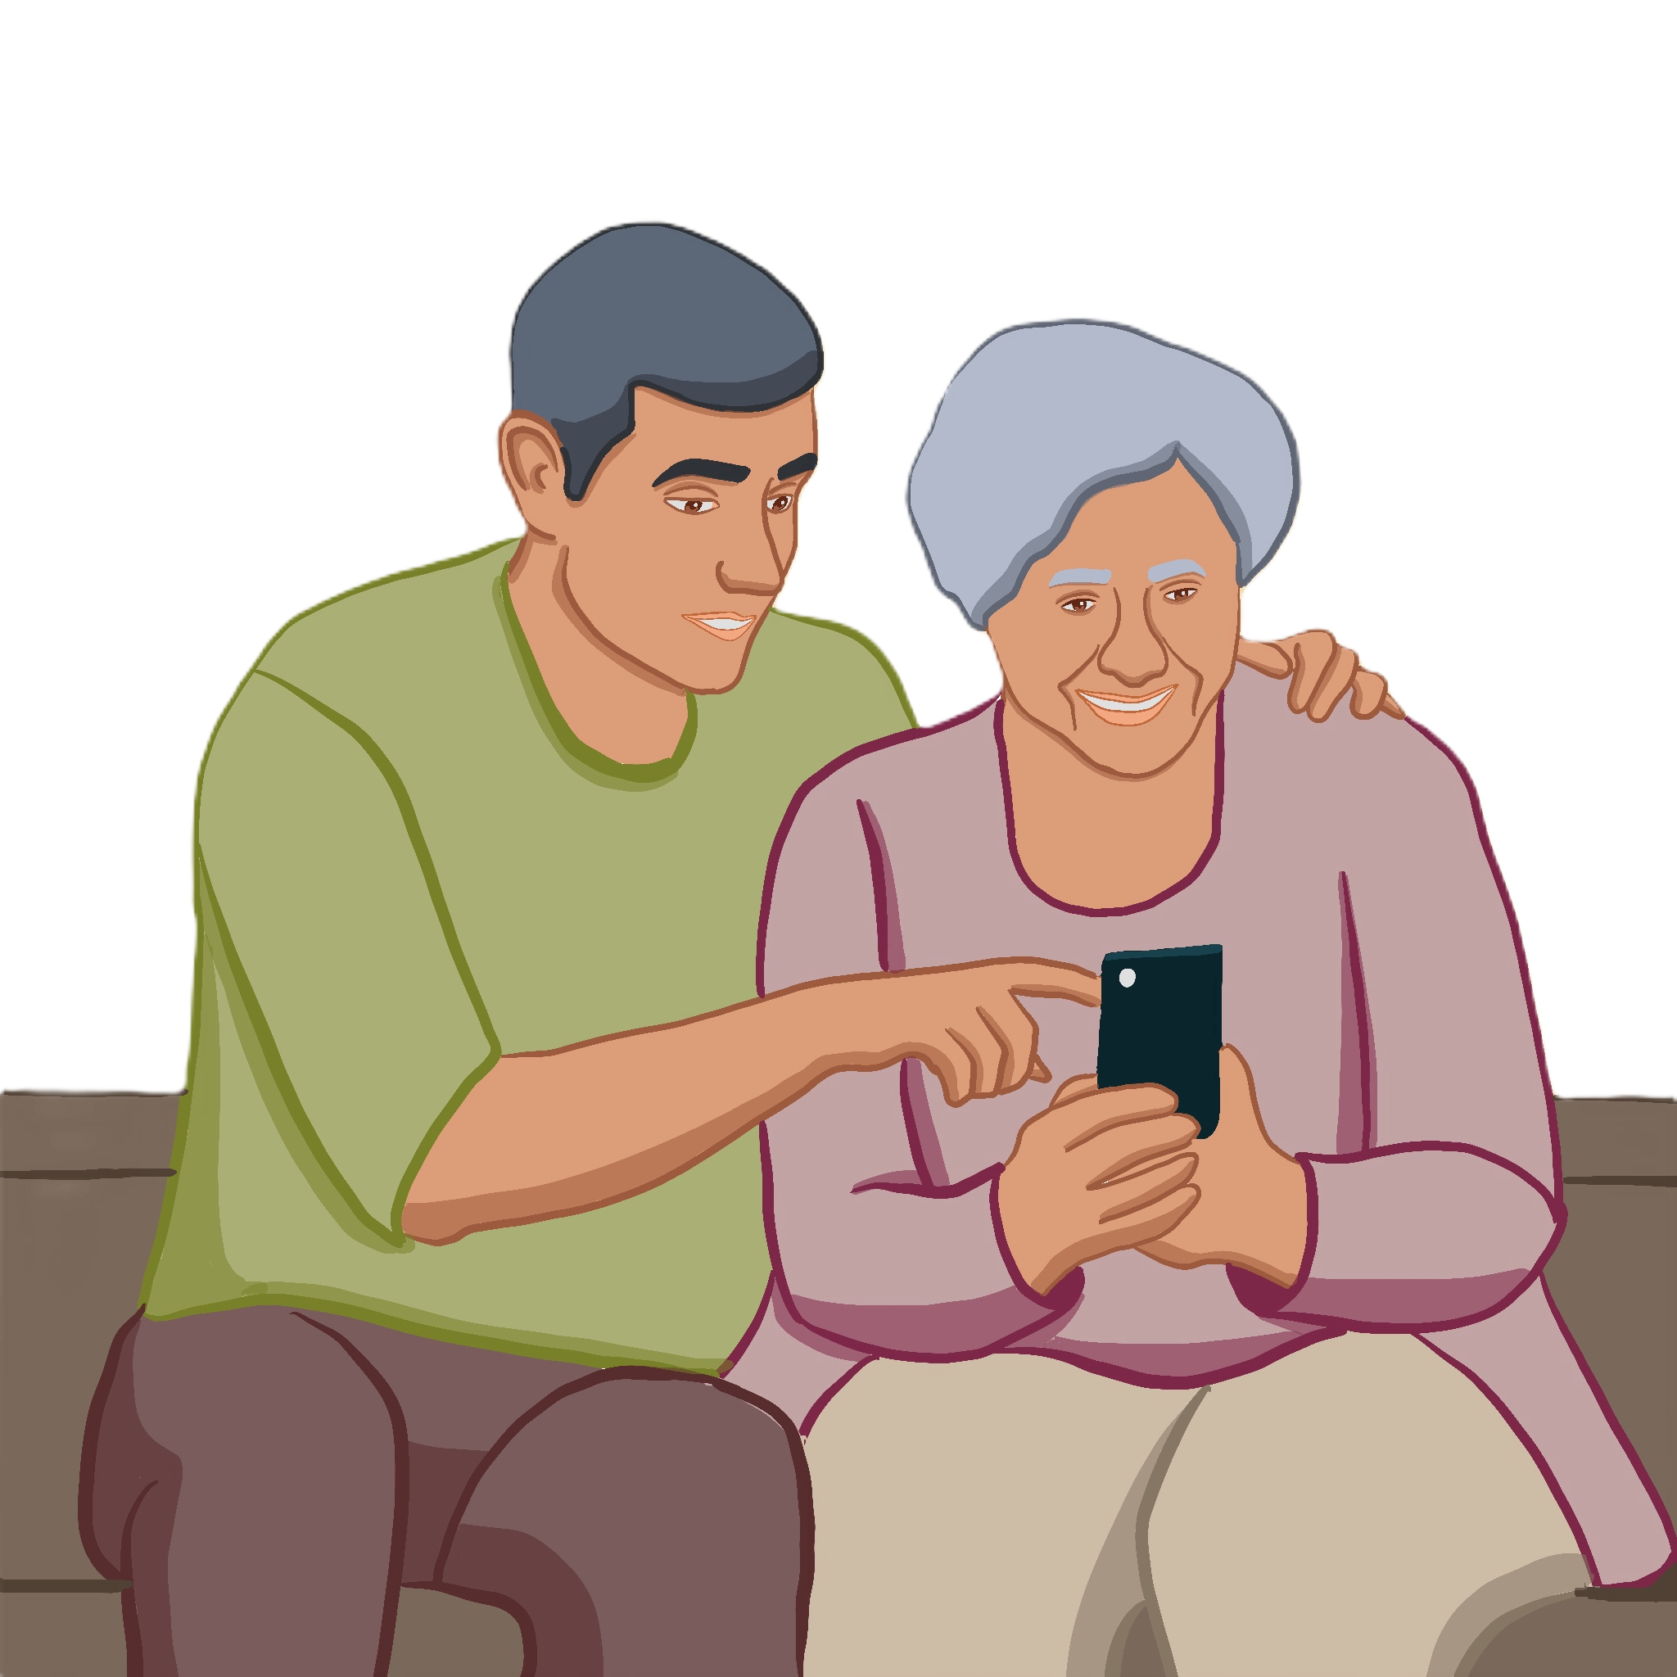
Challenges
For providers
For disabled people
For whānau and other supporters
Innovation
Volition
Results
Notes:
1 in 10 kiwis is an unpaid carer.
Parents that are terrified about what happens to the information in their head when they die, they’ve got ringbinders full of documentaytion just to try and prepare.
Locked into caring dependencies because no one else knows how to care for their loved one.

Slide 10
Challenges
For providers
For disabled people
For whānau and other supporters
Innovation
Volition
Results

Slide 11
Challenges
For providers
For disabled people
For whānau and other supporters
Innovation
Volition
Results

Slide 12
Notes:
At Volition we believe in self-determination – that everyone can be a decision maker in their own lives. We give them the smart and simple tools to make this possible.

Slide 13
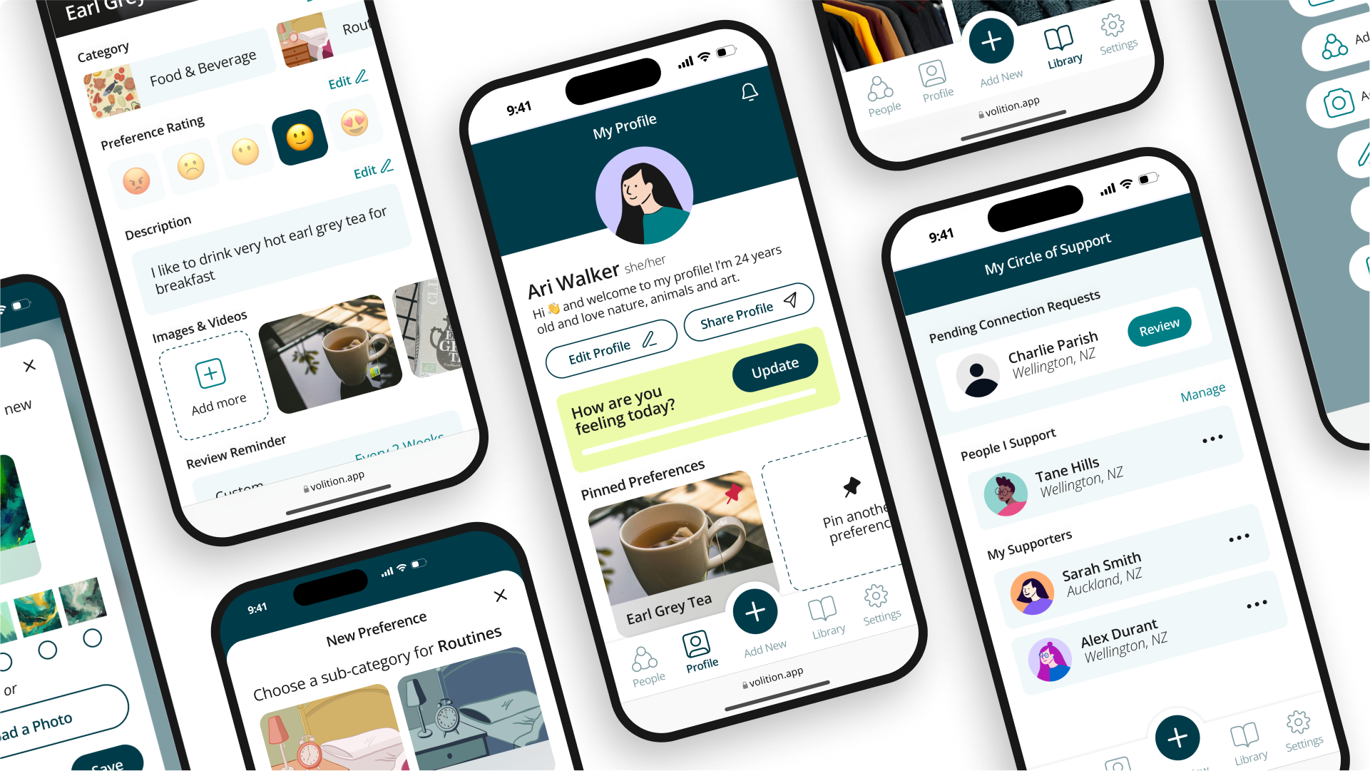
Notes:
We have built an app that helps disabled people to explore, capture and communicate what is important to them. This can be in relation to what they have on their toast or what they want in their end of life planning and advanced directives.
Volition is your preference bank and personal database in your pocket.

Slide 14
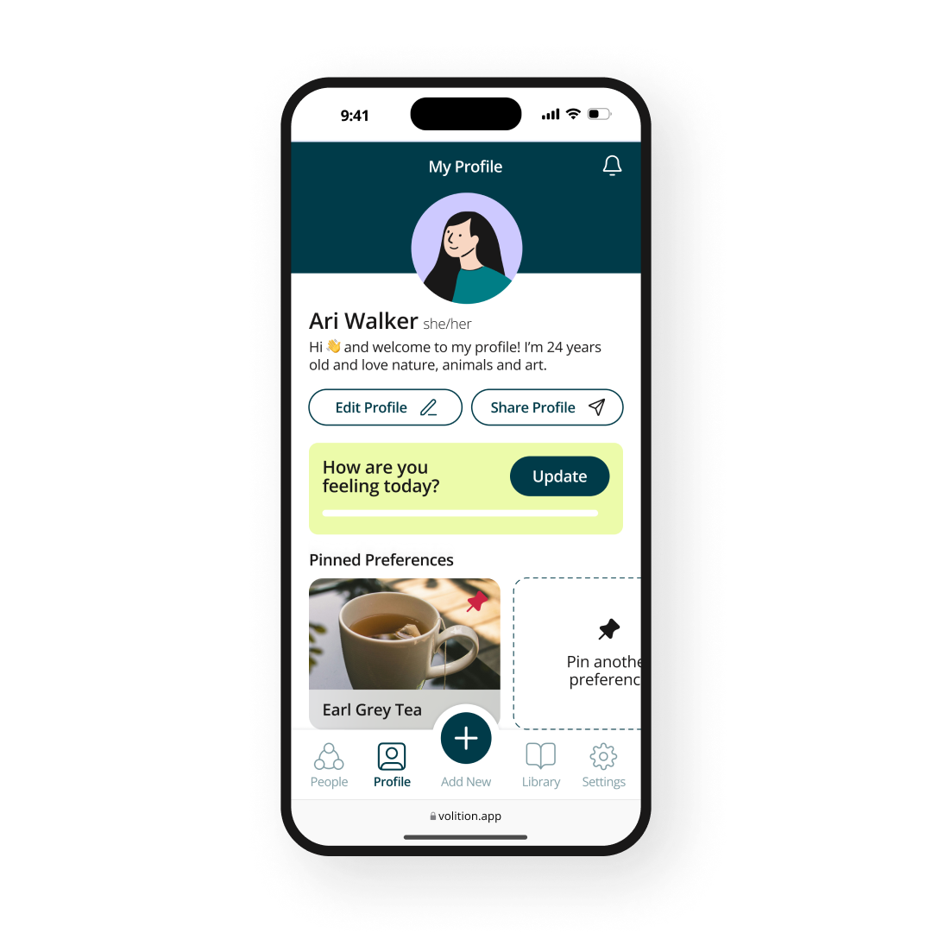
Notes:
They can take pictures, videos or record audio of what they like and what they don’t like, and organise and save that information in the way that makes sense to them.
They can choose what information they share and who they share it with, because data sovereignty is really important to us.
If they choose to share their preference profiles with their support providers, then providers can access genuine client voice and feedback in real time, which in terms of data, is pure gold. This means that providers can plan, deliver and report on their services better, and every body wins.

Slide 15
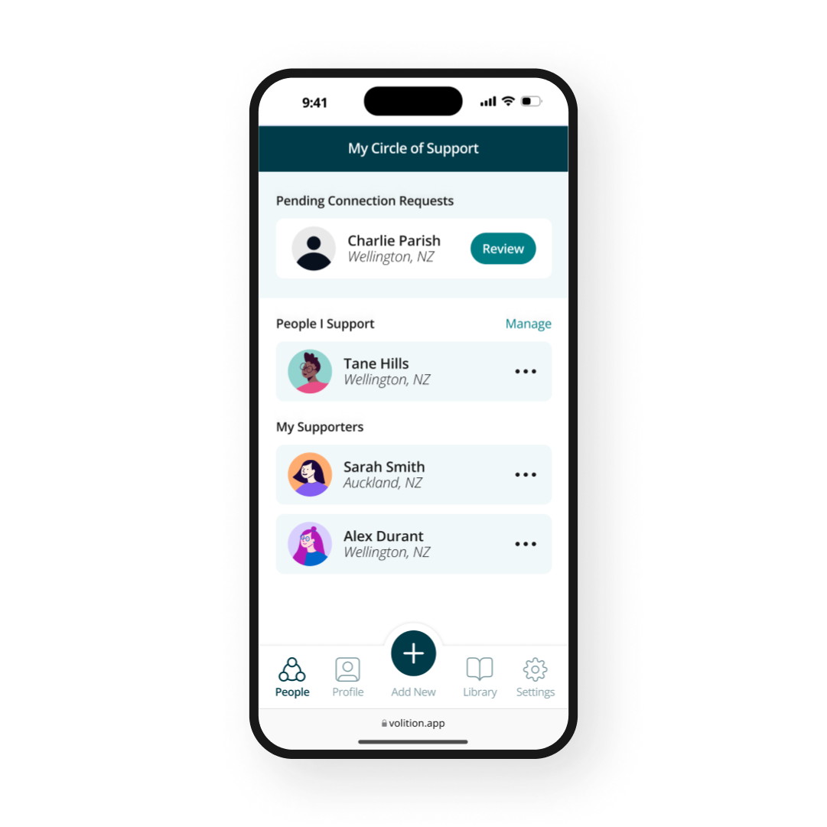
Notes:
The app is built to be accessible, so Decision Makers can use the app by themselves, or they can use it and collaborate together with their chosen supporters. Each supporter has their own log in so support that is offered is trackable, supporters are accountable, and if appropriate, their support can be peer reviewed.
In some cases, Supporters may use the app on behalf of the Decision Maker they support in a wholly facilitated manner. This will most likely be the case where the Decision Maker has profound and multiple learning disabilities. I hope you took notice of the words I just used, because even in this situation, when the person being supported has profound and multiple learning disabilities and may not communicate in an intentional or verbal way, with Volition, they are still the decision maker.
Their supporters can use Volition to capture non-verbal expressions of preference on camera or microphone, and then Volition guides them to catalogue these multimedia recordings of behaviour to analyse, decode and understand meaning.

Slide 16
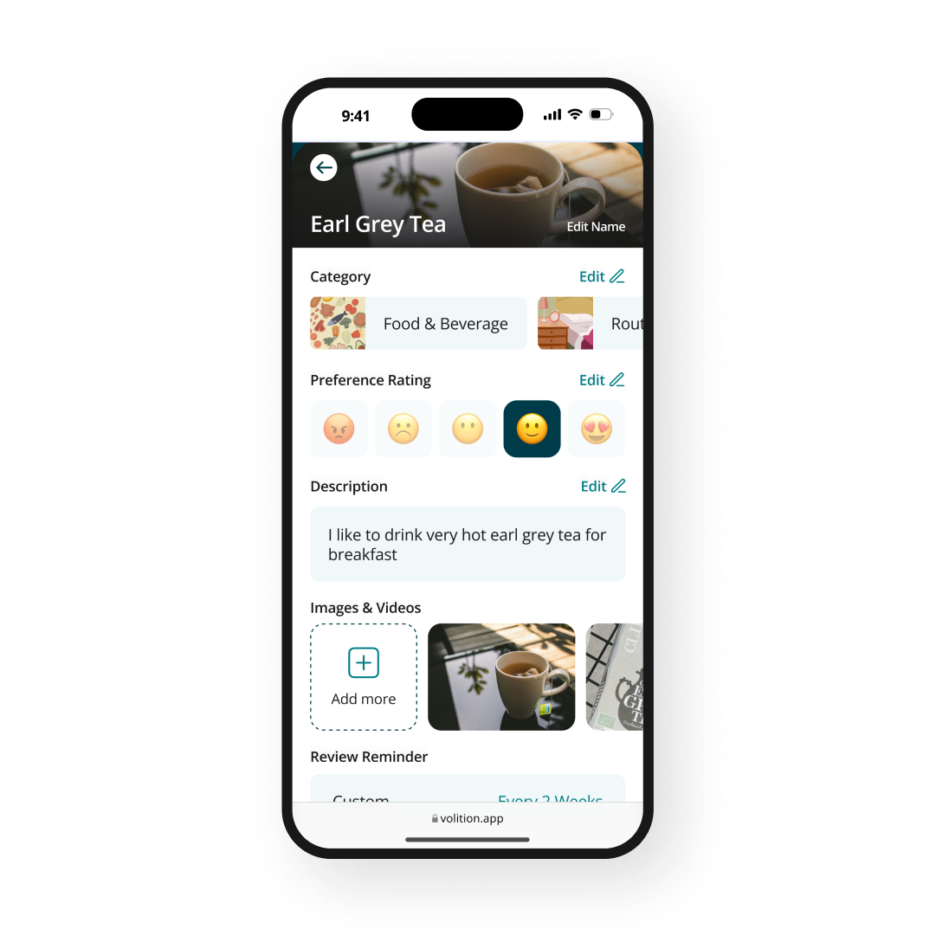

Slide 17
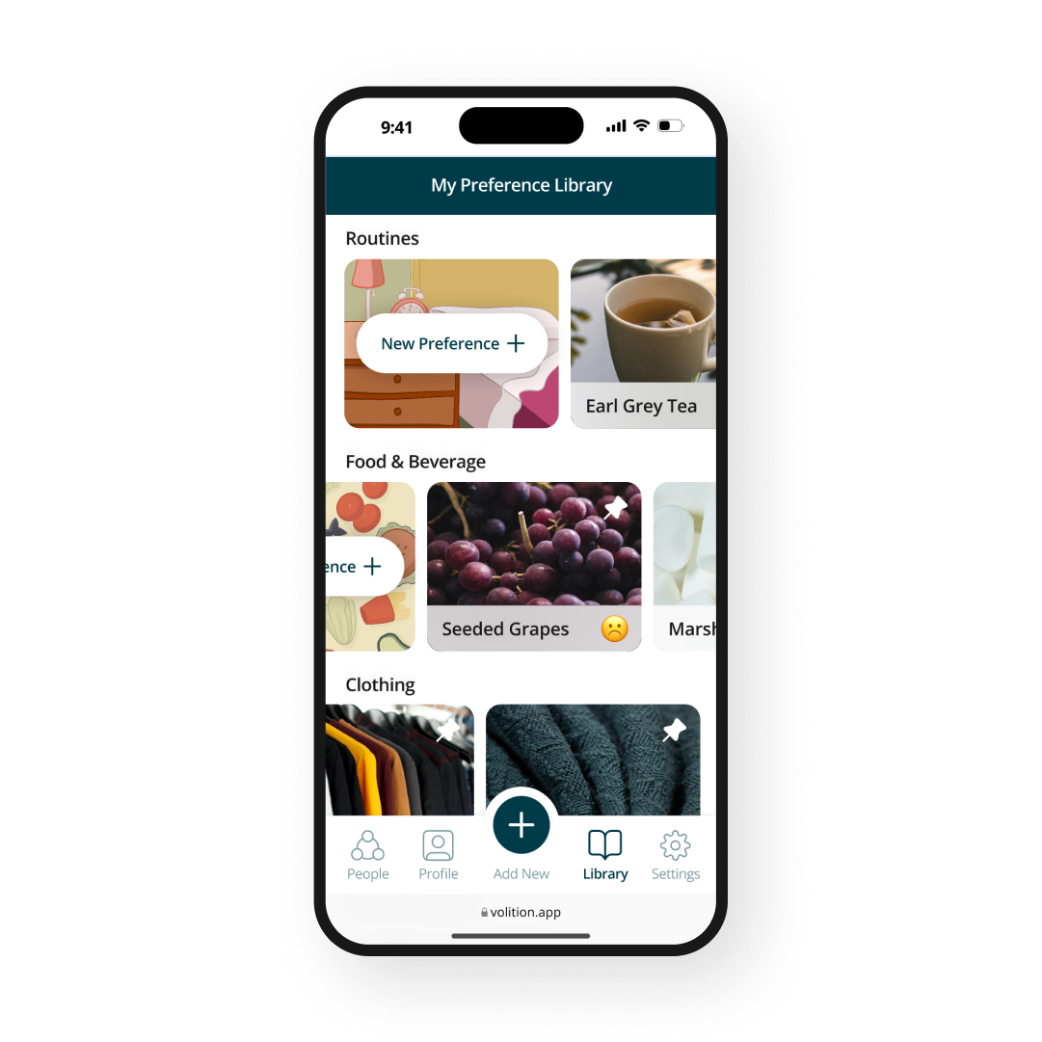

Slide 18
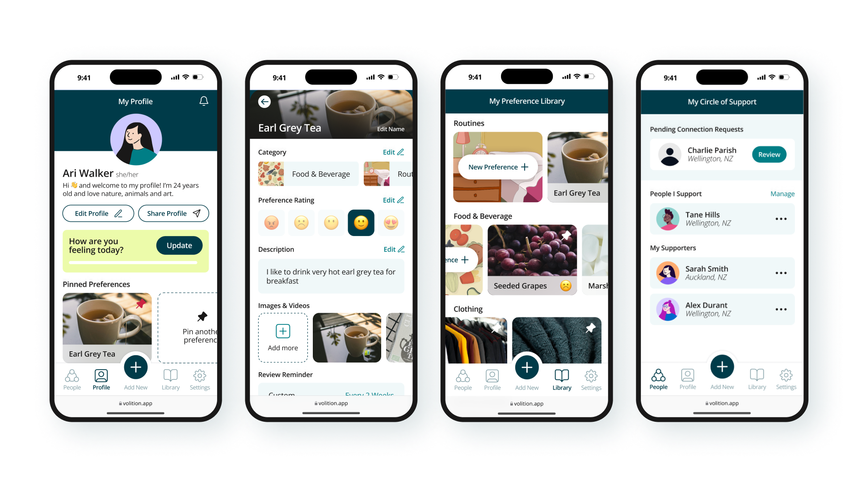
Notes:
Freemium – one supporter and limited storage
Premium – unlimited supporters and a lot more storage
Custom API integrations for providers

Slide 19
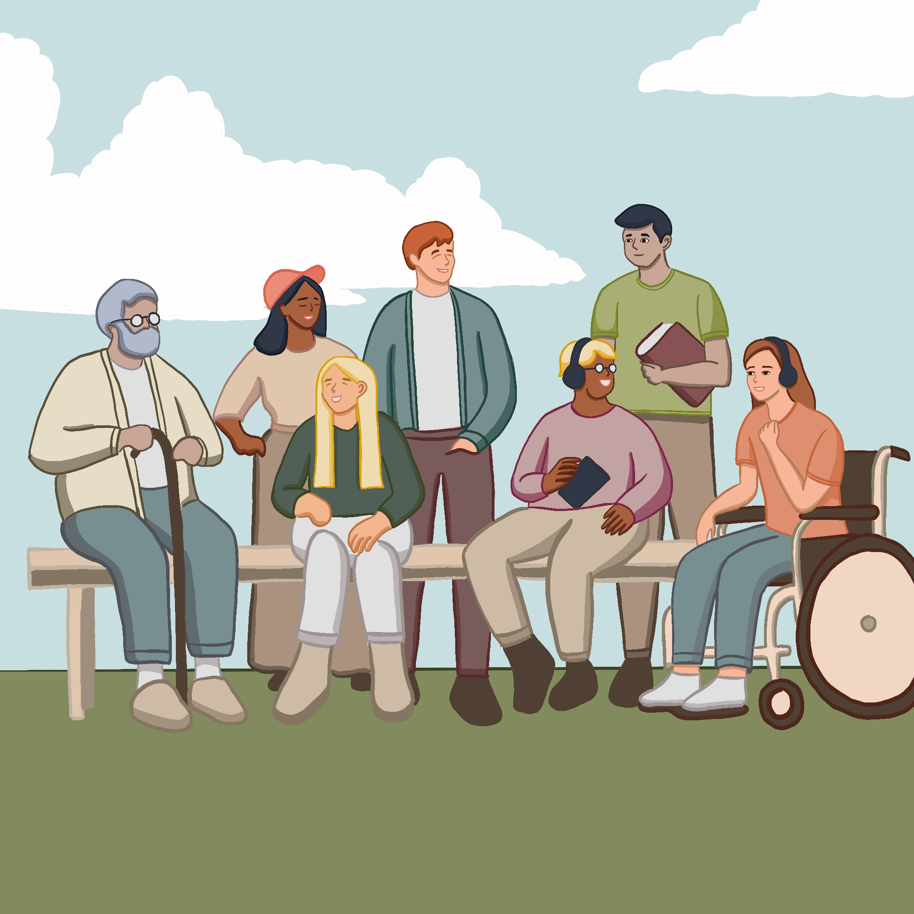
Supported
Decision
Making
(SDM)
Whakawhanaungatanga
What
Who
Why
Where
How
Examples

Slide 20
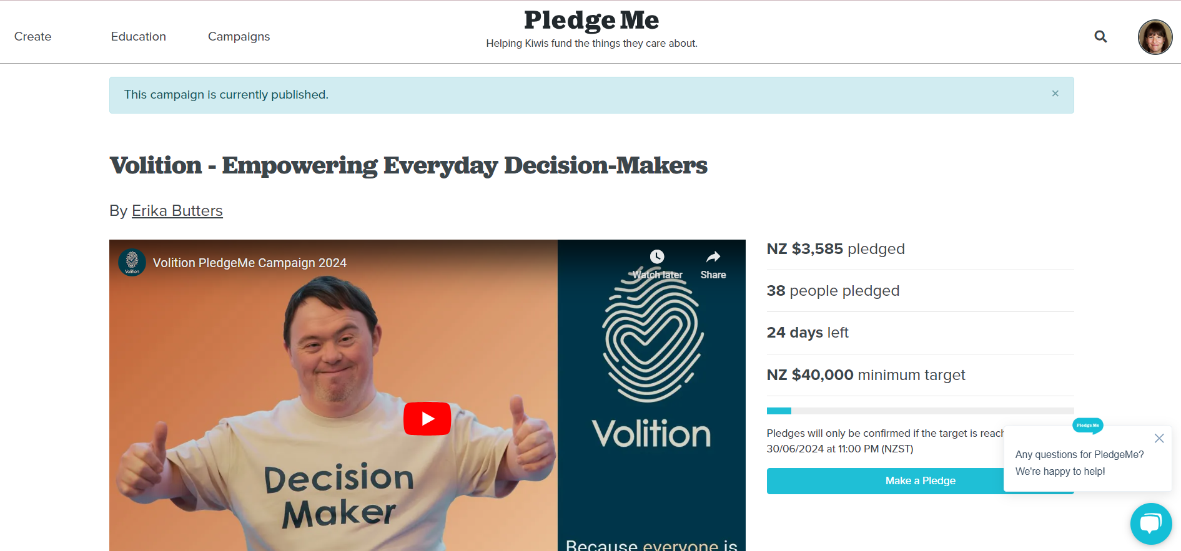
Notes:
About Neville as my Chief Advisor – we went to high school together, he is an entrepreneur
Team of 11 volunteers

Slide 22
Challenges
For providers
For disabled people
For whānau and other supporters
Innovation
Volition
Results

Slide 23
?

Slide 24
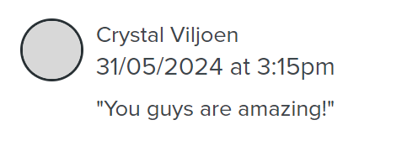
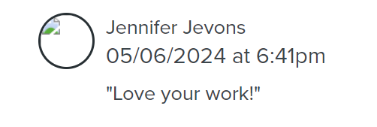
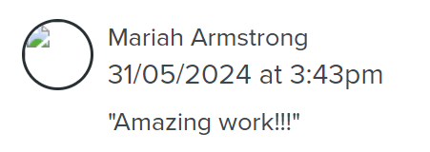
?

Slide 25
“I couldn’t count the number of times I have said or thought ‘I should be recording this.’”
- Lisa Martin, Complex Care Group

Slide 26
“any Provider would be crazy to say no to a succinct way of tracking…the user’s voice.”
- CEO, Disability Service Provider

Slide 27
“I’ve got to repeat myself…I need to tell [them] what I like and don’t like.”
- Disabled Person

Slide 28
“Awesome!!!”
- Disabled Person

Slide 29
www.Volition.org.nz
Erika.Butters@Volition.org.nz

