Slide 1
Expansion of Auckland Disability Law’s Community Education Sessions Nationwide

Slide 2
Our Work
Free legal advice for Deaf and disabled clients
Free legal education seminars
Law reform work

Slide 3
The Major Legal Challenges Facing the Deaf and Disabled Community
67% of disabled people aged 15+ are financially disadvantaged
18% of disabled people have low education levels
11% of disabled people have poor English proficiency
People with intellectual disability are 10 times more likely to experience violence and 3 times more likely to be victims of assault, sexual assault and robbery than people without an intellectual disability
Over 40% of disabled people have substantial and multiple legal problems
50% of adult prisoners have a disability
25% of Māori are disabled

Slide 4
The Challenge:
How to deliver our education seminars nationwide?

Slide 5
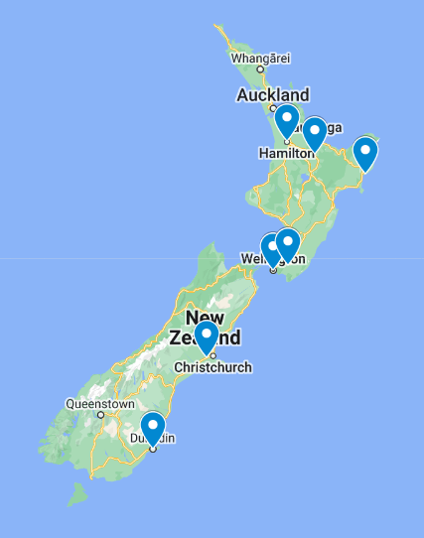
14 seminars to 200+ people since January

Slide 6
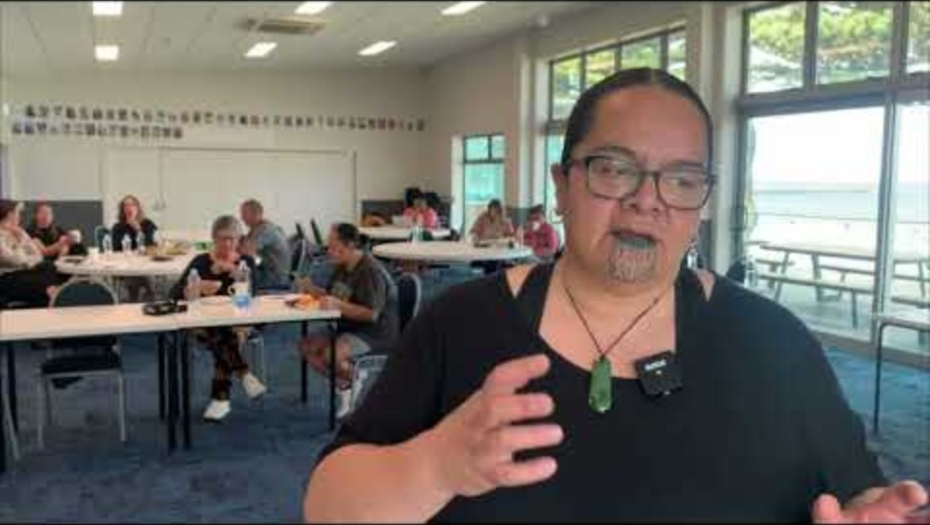
Auckland Disability Law - proudly funded by Spectrum Foundation - YouTube

Slide 7
Contact Details
Phone: 09 257 5140
Text: 027 457 5140
Email: info@adl.org.nz
Website: aucklanddisabilitylaw.org.nz

Slide 8
Disclaimer
This presentation is intended to only provide a general overview of Auckland Disability Law’s services as at 17/06/2024, and is provided for education purposes only. It is not, and should not be taken to be, comprehensive or specific legal advice.
Please do not share the contents of this presentation without first obtaining permission from Auckland Disability Law.
Please do not act in reliance on any information or statement contained in this presentation without first consulting an appropriate legal professional, who will be able to advise you around your specific circumstances.

